Slide 1
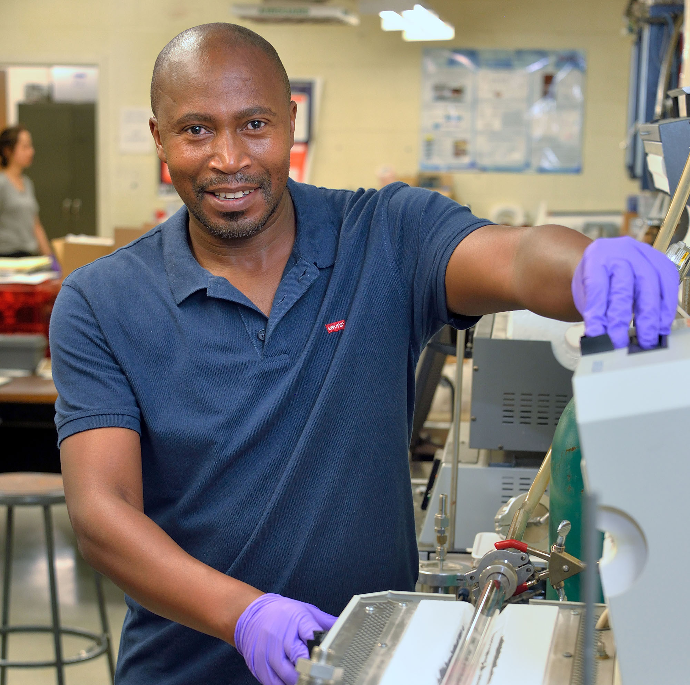
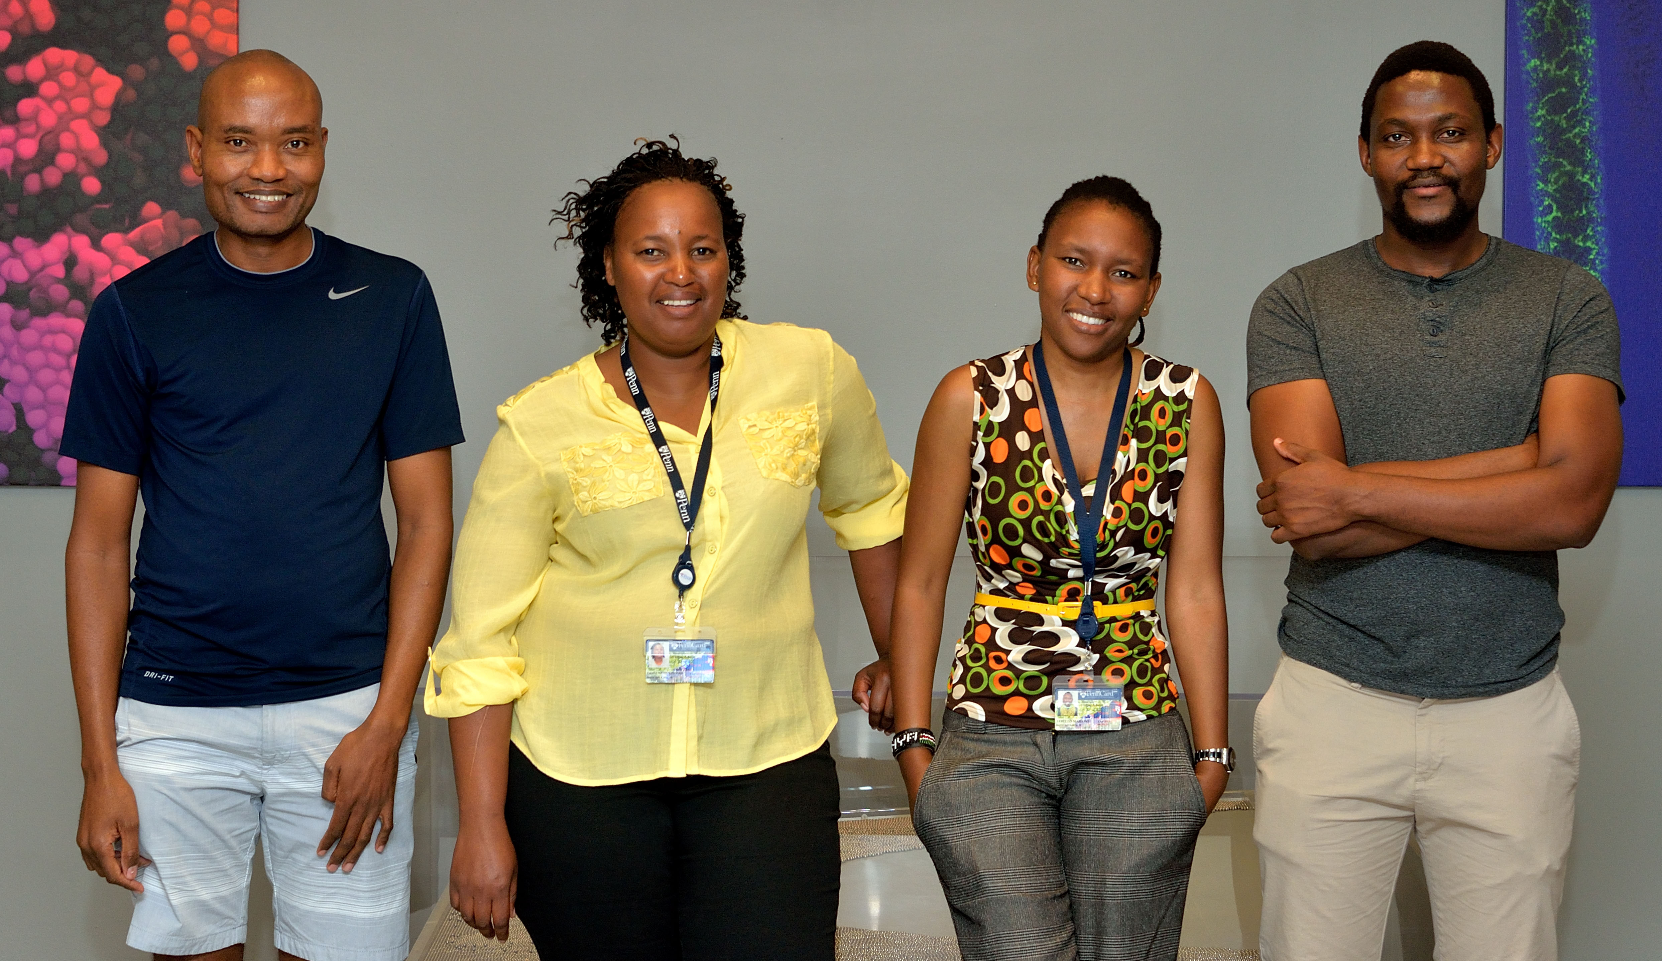
Program with Southern Africa
DMR: 1720530
2019
Mark Licurse & Ashley Wallace. University of Pennsylvania
Since 2003 we have successfully partnered with universities in Southern Africa, specifically the National University of Lesotho and the University of Pretoria, to bring faculty members to the LRSM every summer to participate in collaborative research projects with our faculty. Often the students of faculty members are invited to join as well to gain research experience. This was the case with Mopeli Fabiane (top picture), who originally came as a lecturer, then a graduate student, and now continues to visit as a researcher with his Ph.D. The program started with 2-3 faculty/students visiting each summer and now this summer, 2019, will support 7 visitors (6 faculty and 1 student).
Top: Mopeli Fabiane – Summer 2017: working in the lab of Prof. Charlie Johnson on the “Influence of growth kinetics on graphene domain shape under atmospheric pressure chemical vapor deposition."
Bottom: Prof. Moeketsi Mpholo (National U. of Lesotho), and his graduate student, Teboho Nchaba (U. of Cape Town) worked with Prof. Bau (MEAM). Palesa Phooko worked with Prof. Thomson (and now Prof. Anna in 2019). Dr. Tebello Mahamo (National U. of Lesotho) worked with Prof. Berry (and now Prof. Tomson in 2019).
Mopeli Fabiane
(Left to Right) Moeketsi Mpholo,, Tebello Mahamo, Palesa Phooko, and Teboho Nchaba.
Notes:
Top: Mopeli Fabiane – working in the lab of Prof. Charlie Johnson on the “Influence of growth kinetics on graphene domain shape under atmospheric pressure chemical vapor deposition."
Bottom: Prof. Moeketsi Mpholo (Left, National U. of Lesotho), and his graduate student, Teboho Nchaba (Right, U. of Cape Town) spent 8 weeks at Penn working with Prof. Bau (MEAM). Dr. Tebello Mahamo (middle right, National U. of Lesotho) and Palesa Phooko, Chemistry, (middle left, National U. of Lesotho) both spent one month working with Profs. Thomson and Berry, Chemistry, respectively.

