Slide 1
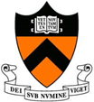
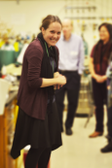
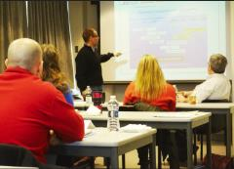
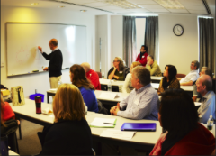
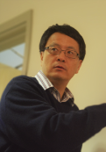
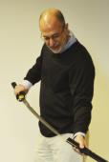
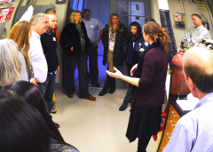
2015 Teachers as Scholars Science: DMR 1420541
Princeton Center for Complex Materials (PCCM)
Dan Steinberg, Claire White, Nan Yao, Howard Stone, Janine Nunez, Bob Cava
Teachers as Scholars Materials Science program
On November 10 and 17 2015, 18 teachers visited the Princeton Center for Complex Materials as part of Teacher Prep’s to learn about Materials Science and how to apply it in the classroom. This unique PCCM program is part of a larger Teachers as Scholars initiative of Princeton University’s Teacher Preparation program.
The teachers toured PCCM labs and facilities. They also discussed the interdisciplinary nature of science from many of PCCM’s scientists and engineers, including Professors Bob Cava, Rick Register, Rod Priestley, Claire White, Nan Yao, and several graduate students.
PCCM members led guided discussions on how to apply what they learned in compliance with the new Next Generation Science Standards.

