Slide 1
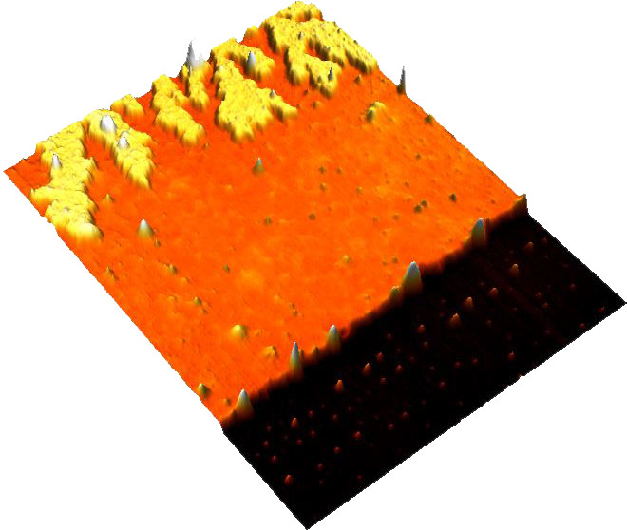
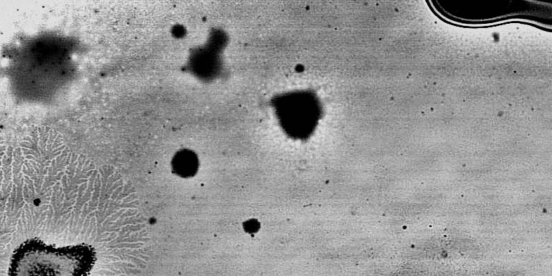
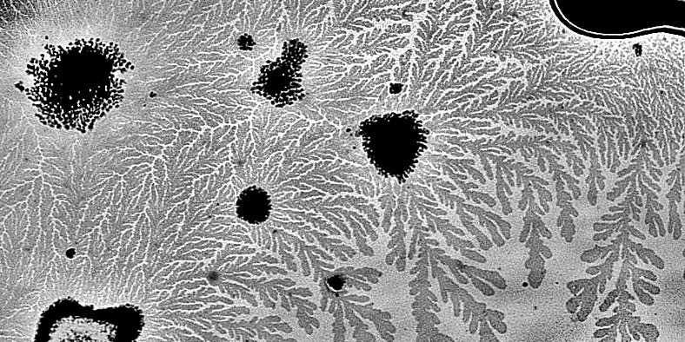
IRG-2: MAPLE of Polymer Films for Morphology Control (DMR-1420541) Craig Arnold, Lynn Loo, Rodney Priestley, Princeton University
A
B
Crystalline
phase
C
liquid PEO
(adsorbed)
R1
crystal
Liquid
Substrate (Si)
Liquid phase
(stable)
Longer MAPLE
Time 0
No crystallization
at interface
Si substrate
overlayer
Crystalline
Time 1h
We found that deposition temperature can significantly affect the stability of liquid phase PEO in MAPLE-deposited films, which results in different crystallization kinetics. While adsorbed PEO deposited at lower temperature maintains its liquid phase during aging, adsorbed PEO deposited at higher temperature transforms into crystalline phase under the same aging conditions. While crystallization kinetics in polymer thin films has been described as a function of temperature and thickness, our results may indicate that thermal history of the films also affect the kinetics.
(A) Schematic showing the evolution of film morphology in MAPLE with increasing deposition time. The growth of primary MLCs is blocked by thick adsorbed liquid layers and covered with liquid overlayer.
(B) AFM height image showing the film morphology after 6 h of deposition at 25 °C. The film was scraped with a razor blade to address PEO-coated regions. The figure clearly depicts the dendritic crystals surrounded by liquid phase PEO.
(C) Optical microscopy images showing the crystallization process in a PEO film made with MAPLE at 50 °C. The film was quickly transferred to a 25 °C stage for aging. The upper panel shows the morphology right after nucleation, and the lower panel shows the morphology after 1 hour where crystal growth propagated throughout the whole adsorbed liquid phase. Image size is 100 X 50 μm² for each panel.

