Slide 1
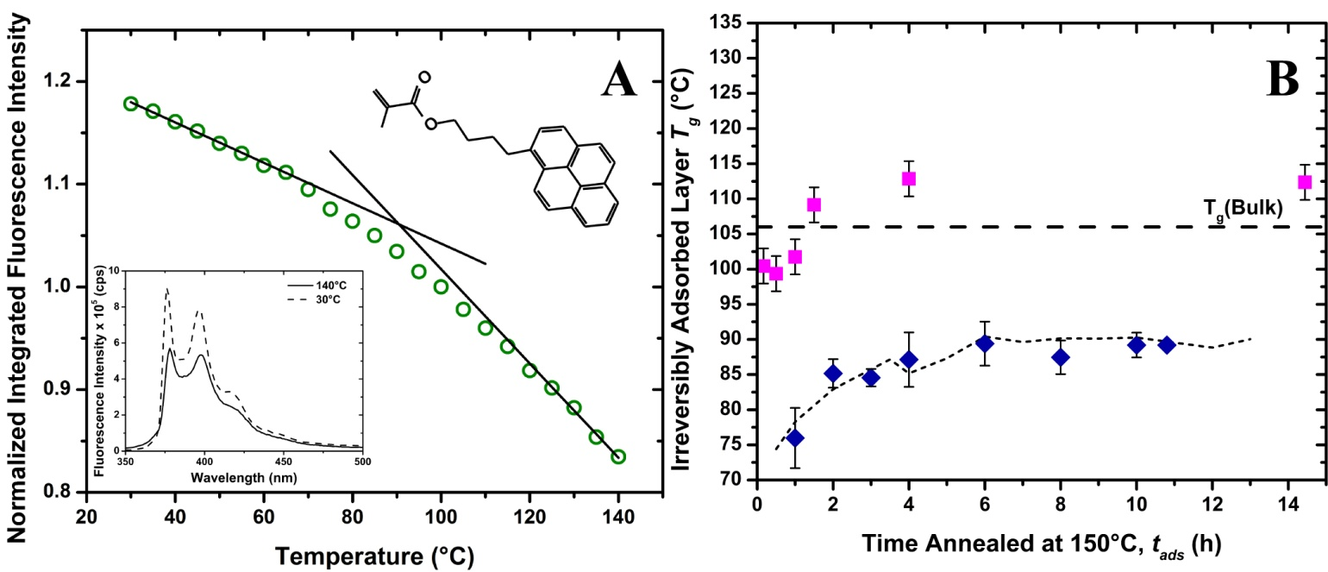
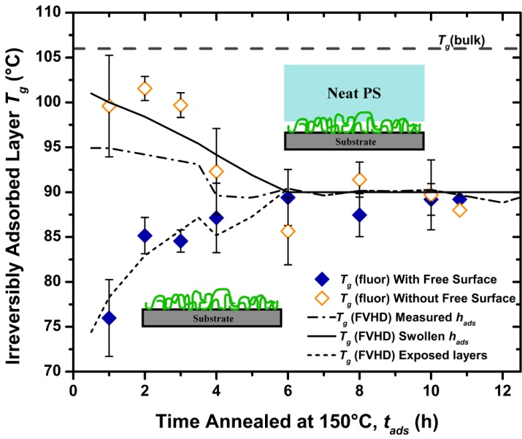
IRG-2: Glass Transition of Irreversibly Adsorbed Nanolayers (DMR-1420541) Rodney Priestley, Richard Register, Princeton University
Thin polymer films in contact with a substrate serve as the enabling material for a range of emerging technologies, including nanoimprint and block copolymer lithography for microelectronics, membranes for efficient separations and drug delivery, and semiconductors for organic solar cells and electronics. A critical step in film production is thermal annealing the polymer film in the melt state to remove excess solvent, relax residual stresses and thermal history induced during formation, and—in the case of block copolymer films—induce self-assembly. During prolonged melt-state annealing, monomer-substrate interactions on the order of k_{B}T can lead to the formation of an irreversibly adsorbed (or physically bound) nanolayer. This adsorbed layer has been linked to changes in thin film properties and its formation has many implications in determining the glass transition temperature (Tg) of confined polymer films– which is known to depend heavily on interfacial interactions. PCCM researchers are investigating how the T_{g} of this adsorbed layer is influenced by the free surface and employing a fluorescence technique to directly measure the T_{g} of the adsorbed layer buried in a film.
T_{g} of Exposed Irreversibly Adsorbed layers via Fluorescence (A) The temperature dependence of fluorescence intensity for a 10-h irreversibly adsorbed layer, with solid lines being linear fits to the high and low temperature data. Lower inset shows temperature dependence of its spectra. Upper inset shows molecular structure of pyrenebutanol methacrylate monomer co-polymerized with styrene at low concentrations in lPS; (B) Exposed adsorbed layer T_{g} at different t_{ads} as measured by fluorescence (diamonds) and as reported for capped adsorbed layers by Napolitano²(squares), shifted to match respective T_{g}(bulk) values. Dashed line illustrates predictions by free volume holes diffusion model (FVHD).
Irreversibly adsorbed layer T_{g} with and without a free surface as a function of adsorption time, t_{ads}. Insets illustrate exposed and buried adsorbed layer geometries. Lines show T_{g} predicted by FVHD for exposed and submerged adsorbed layers.
Reference: Mary J. Burroughs, Simone Napolitano, Daniele Cangialosi, and Rodney D. Priestley, Direct Measurement of Glass Transition Temperature in Exposed and Buried Adsorbed Polymer Nanolayers, Submitted (2016).
Notes:
Abstract: We employ a fluorescence bilayer method to directly measure the glass transition temperature (T_{g}) of the irreversibly adsorbed layer of polystyrene (PS) buried in bulk films as a function of adsorption time, t_{ads}. This bilayer geometry allows for the examination of interfacial effects on T_{g} of the adsorbed nanolayer. In the presence of a free surface, we observe a substantial reduction in T_{g} from bulk that lessens with t_{ads} as a result of increased chain adsorption at the substrate. Submerging the adsorbed layer and effectively removing the free surface results in a suppression of the T_{g} deviation at early t_{ads}, suggesting chain adsorption dictates T_{g} at long t_{ads}. Annealing in the bilayer geometry promotes recovery of bulk T_{g} on a timescale reflecting the degree of adsorption. Our data are quantitatively rationalized via the Free Volume Holes Diffusion model, which explains adsorbed nanolayer T_{g} in terms of the diffusion of free volume pockets towards interfacial sinks.

