Slide 1
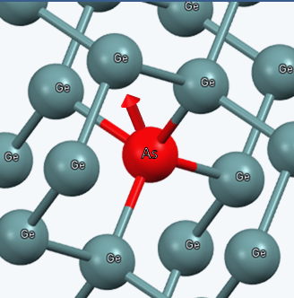
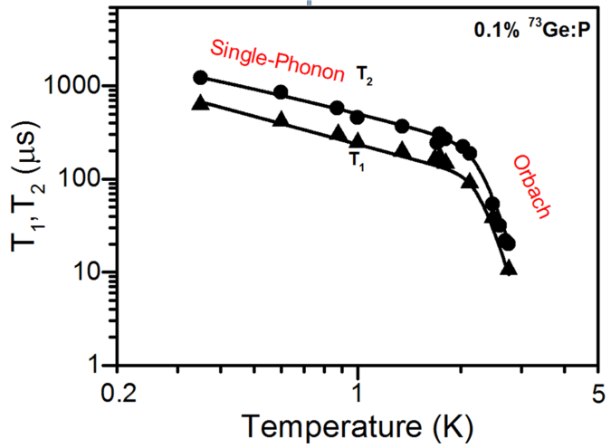
IRG-3 Electron Spin Coherence of Shallow Donors in Germanium (DMR 01420541)
Anthony Sigillito,¹ Ryan Jock,¹ Alexei Tyryshkin,¹ J.W. Beeman,²
E.E. Haller,^{2,3} Kohei Itoh,⁴ and Stephen Lyon¹
¹Princeton University; ²LBNL; ³UC Berkeley; ⁴Keio University
The magnetic moment, or spin, of an electron which is bound to an impurity atom in silicon is exceptionally coherent, an important feature for its use as a quantum bit (qubit) in a quantum computer. However, those electrons are not easily controlled by electric fields. Electron spins in germanium are over 10,000 times more sensitive to an electric field, but it was not known if they would have long coherence. Recently, an international collaboration led by IRG3 researchers have measured electron spin coherence in germanium for the first time.¹ The new data show that these electron spins can have coherence times of over 1 ms, and the evidence points to even longer coherence at lower temperatures. These results suggest that germanium is a good material for electron spin qubits.
1. A. Sigillito, et al., Phys. Rev. Lett. 115, 247601 (2015).
Fig. 1 Depiction of an arsenic impurity atom (red ball labeled As) in a host crystal of germanium atoms (labeled Ge). The arsenic atom forms chemical bonds with four germanium atoms, but the As atom has one more electron than the Ge atoms. The red arrow indicates the direction of the magnetic moment of this extra electron.
Fig. 2 Plots of the time that the spin of the extra electron associated with a phosphorus impurity atom in Ge remains coherent (T₂) and does not flip (T₁) at different temperatures. At higher temperature the coherence is found to be controlled by an Orbach process, while single phonon processes dominate at lower temperature. At the lowest temperature (0.3 K) the coherence time is over 1 ms.

