Slide 1
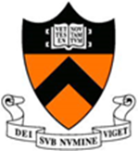
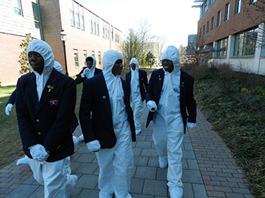
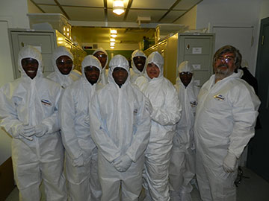
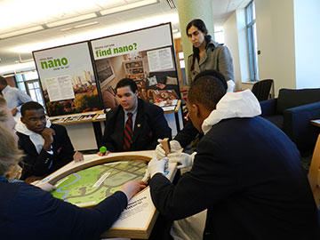
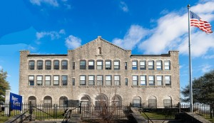
Outreach: Latin School for Boys Visit (DMR- 0819860)
Daniel Steinberg, N. P. Ong
Princeton Center for Complex Materials (PCCM)
On March 13, 2013, students from Philadelphia's Latin School visited the Princeton Center for Complex Materials. The 9th and 10th graders came to PCCM from the largely African American all boys charter school in Philadelphia. Their teacher, Christine Galib, a Princeton University alum, has been teaching her students about nanotechnology. She saw a talk by PCCM's Professor Michael McAlpine and wanted to inspire her students about nanomaterials. The students toured the Imaging and Analysis Center and the Micro- Nano-Fabrication Lab. The students also walked through the Art of Science exhibit, still wearing their MNFL cleanroom "bunny suits,“, a tour of our “Art of Science” gallery and then to the Princeton Public Library. NISENet trained Library staff and outreach director Steinberg guided them in activities and our NSF funded NISEnet Nano! Exhibit.
Contact Education & Outreach Director Dr. Daniel Steinberg for more information: dsteinbe@princeton.edu or 609-258-5598
http://www.princeton.edu/pccmeducation

