Slide 1
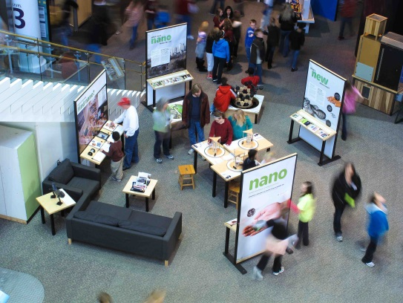
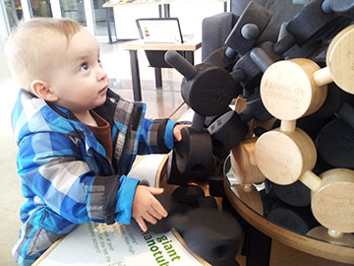
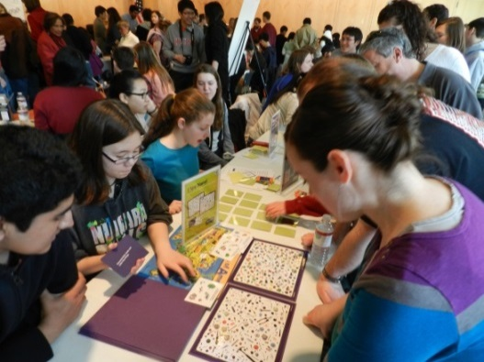
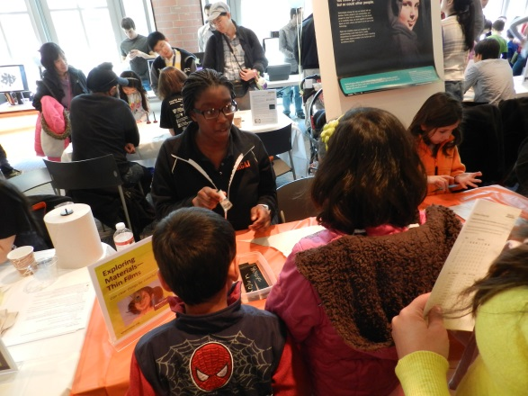
Outreach: Nano Mini-Exhibit (DMR- 0819860)
Daniel Steinberg, Susan Conlon, David Parris, N. P. Ong Princeton Center for Complex Materials (PCCM)
In 2012, Princeton University’s NSF-funded research center Princeton Center for Complex Materials (PCCM) and its partners the Princeton Public Library and the New Jersey State Museum were awarded the NSF funded NISEnet Nano! Mini-Exhibit. Nano! is a new engaging exhibition for family audiences about nanoscale science, technology, and engineering. The Nano! Mini-Exhibit is open to the public at the Princeton Public Library for one year. 1000’s have already enjoyed the exhibit. The exhibit allows the public to imagine and discover the nanoscale world and hoe nanomaterials improve their lives. This 400ft² exhibition includes hands-on, interactive exhibits that invite exploration of nano. Interactive panels provide information on tiny solutions for big problems and exciting technologies inspired by nature. Scientists and engineers from PCCM will lead activities throughout the year using the exhibit.
Contact Education & Outreach Director
Dr. Daniel Steinberg for more information: dsteinbe@princeton.edu or 609-258-5598
http://www.princeton.edu/pccmeducation

