Slide 1
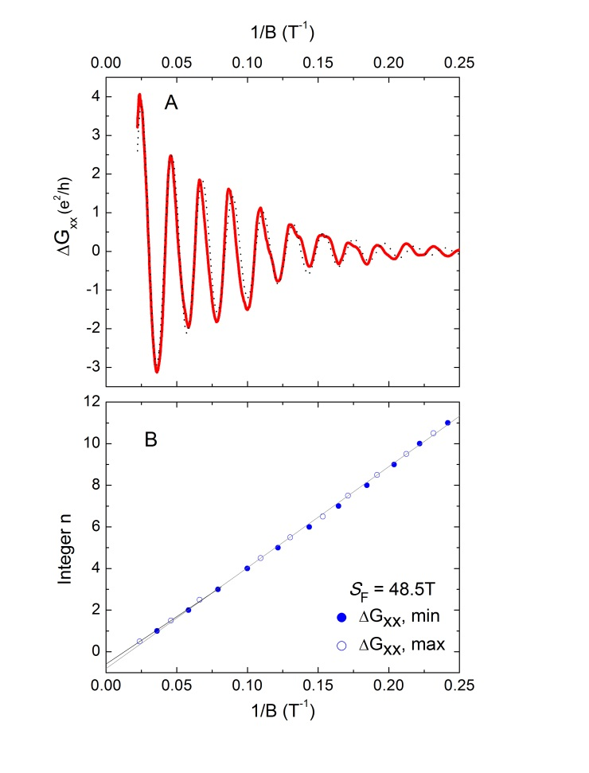
A Key Signature of Dirac Fermions
IRG-A: Jun Xiong, Y.K. Luo, Y. H. Khoo, Shuang Jia, R. J. Cava and N. P. Ong,
DMR-0819860 Princeton Center for Complex Materials (PCCM)
In solids, the kinetic energy of an electron generally increases as the square of its momentum. By contrast, in a Topological Insulator such as Bi₂Te₂Se, electrons on the surface are predicted to be Dirac Fermions for which the energy increases linearly with momentum. In a magnetic field B, the allowed states of an electron are quantized into Landau Levels (LLs). The sequential emptying of occupied LLs in an increasing field leads to quantum oscillations in the conductance G_{xx} (Fig. 1A). A key signature of Dirac Fermions is the existence of an extra half-period in the oscillations called “π-Berry Phase shift”. (Technically, this arises from the ½ Landau Level that exists at zero energy.) The quantum oscillations provide an elegant way to “count” directly the available levels. By plotting the fields B_{n} of the minima in G_{xx} against the integer n (n counts the number of levels still to be emptied), one may determine the ultimate value of n by extrapolation to infinite field (1/B→ 0). Measurements to 45 Teslas on a crystal of Bi₂Te₂Se by Xiong et al. [1] reveal that there is ½ level left (Fig. 1B), consistent with Dirac Fermions. The uncertainties in this experiment are unusually low because of the large number of oscillations observed and the low index of the last datum (n = ½). The results provide firm evidence that the oscillations in Bi₂Te₂Se indeed arise from Dirac Fermions.
1) Jun Xiong, et al., Phys. Rev. B 86, 045314 (2012).
Figure 1A Quantum oscillations in the conductance G_{xx} of Bi₂Te₂Se at 0.7 K to maximum field of 45 T, showing sequential emptying of LLs with increasing B. In Panel B, the fields B_{n} at the minima of G_{xx} fall on a straight line with an intercept -1/2 at 1/B = 0.

