Slide 1
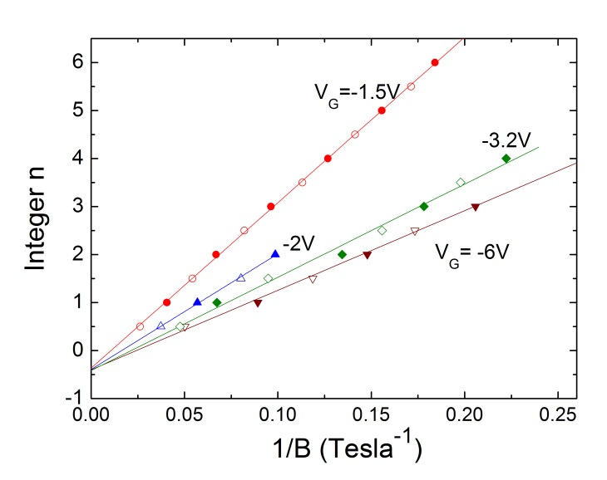
Tuning Population of Dirac Fermions by Ionic-Liquid Gating
IRG-A: Jun Xiong, Y. H. Khoo, Shuang Jia, R. J. Cava and N. P. Ong,
DMR-0819860 Princeton Center for Complex Materials (PCCM)
A
Ionic liquid
DEME-TFSI
In the topological insulator Bi₂Te₂Se, the electrical current is carried by both the surface electrons (“Dirac Fermions”) and the (unwanted) bulk electrons. To reduce the bulk contribution in a thin-film sample, one can apply a “gate”electric field E_{G} to repel the bulk electrons (gating). Bulk crystals require much larger E_{G}. PCCM researchers recently succeeded in gating crystals using the ionic liquid DEME-TFSI (Fig. 1A). The applied gate voltage V_{G} deposits a layer of anions which create an intense E_{G} on the sample. Cooling the sample to 4 Kelvin freezes the ionic charge configuration. A direct way to see how E_{G} affects the surface electrons is to monitor the quantum oscillations in their resistance versus an applied magnetic field B. The oscillations result from the successive emptying of Landau Levels. A plot of the reciprocal of the peak fields versus the integers yields a straight line whose slope gives the surface population density N_{s}. With increasing E_{G} (V_{G} more negative), N_{s} is seen to decrease, confirming that the Fermi Energy approaches the Dirac Point (Fig. 1B). Moreover, the intercepts of the straight lines remain close to -1/2 in accord with the behavior of Dirac Fermions. The results provide a clean verification that ionic liquid gating strongly affects the population of the Dirac Fermions; the gate voltage directly tunes their quantum oscillations.
Jun Xiong, et al., cond-mat arXiv:1211.1906v2, submitted.
Partial support from the Army Research Office is acknowledged.
Au electrode
cations
V_{G}
anions
drain
source
sample
sapphire
B
Figure 1 A: Sketch of the ionic-liquid gating experiment. The sample and gold electrode are immersed in the liquid DEME-TFSI. A negative gate voltage V_{G} coats the sample with anions. Panel B plots the reciprocals of the fields (at which quantum oscillations peak) versus the integers n. The slope is proportional to the surface concentration N_{s}. Note that, as N_{s} changes, the intercepts remain near -1/2.

