Slide 1

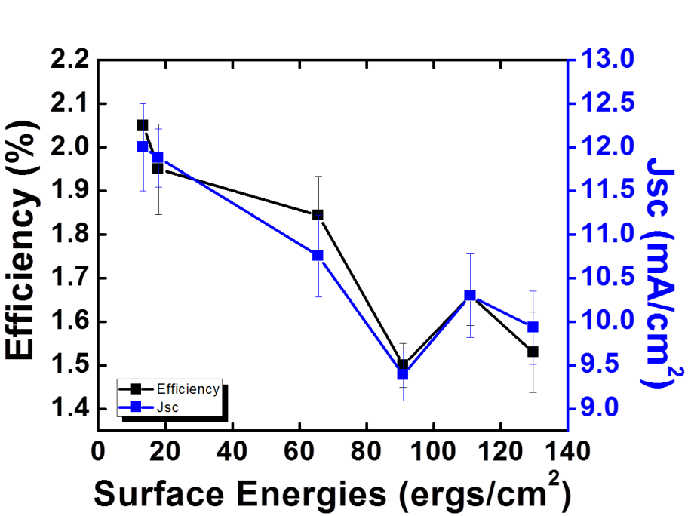
ZnO Nanowire:P3HT Hybrid Solar Cells
IRG-B: Y.-L. Loo, A. Kahn, J. Schwartz (DMR-0819860)
Princeton Center for Complex Materials (PCCM)
We have demonstrated record efficiencies in ZnO nanowire array: poly(3-hexylthiophene), P3HT, bulk-heterojunction solar cells [1]. A sputtered Zn layer that is wet oxidized was used as the seed layer for subsequent growth of vertically oriented ZnO nanowire arrays. The sputtered seed layer is more homogeneous than conventional sol-gel derived seed layers, so the nanowire arrays are more uniform. In addition, the sputtered seed layer also serves as an effective hole-blocking layer.
To further improve the device characteristics, we adsorbed self-assembled monolayers comprising phosphonic acid derivatives on the ZnO nanowires prior to infiltration of P3HT [2]. The treatment passivates surface defects and uniformly improves device characteristics. We observe a strong correlation with the surface energy of the treated ZnO, likely due to varying extents of improvement in the contact between P3HT and ZnO at the charge transfer interface [3].
[1] L.W. Whittaker, A. Woll, D. Smilgies, Y.-L. Loo, submitted 2013.
[2] L.W. Whittaker, W. McClain, J. Schwartz, Y.-L. Loo, in preparation.
[3] L.W. Whittaker, A. Kahn, J. Schwartz, Y.-L. Loo, in preparation.

