Slide 1

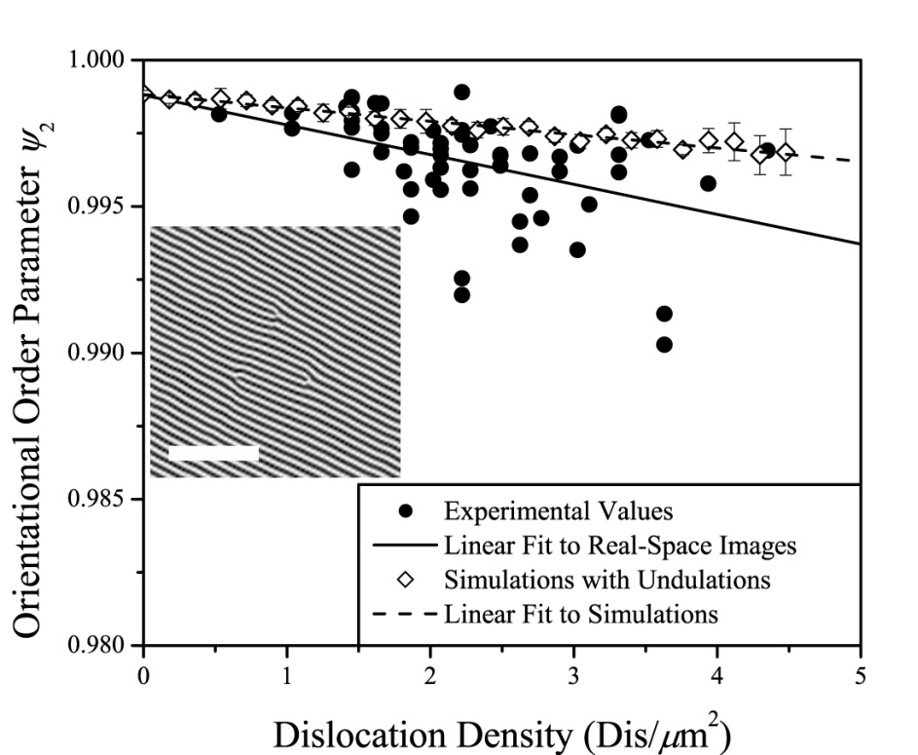
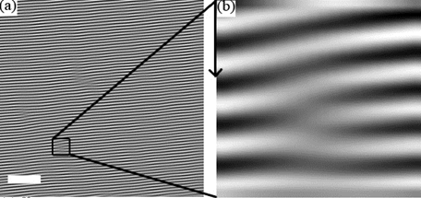
Striving for Perfect Order in Shear-Aligned Block Copolymer Films
IRG-C: Andrew Marencic, Paul Chaikin (NYU), and Rick Register
Princeton Center for Complex Materials (PCCM) (DMR-0819860)
Block copolymer thin films are effective templates for fabricating large arrays of nanoscopic objects; for example, polymers which self-assemble into cylinders lying in the plane of the film yield striped patterns, which can be replicated in metal to yield nanowire grids which effectively polarize the short-wavelength ultraviolet light used in today’s advanced production photolithography. But other applications demand more perfect order of the striped-pattern template: perfectly straight and unbroken wires. The most obvious defects in these block copolymer patterns are isolated dislocations– cylinders which start or stop, which would become breaks in wires fabricated from such a template. PPCM researchers have found that tight control of the film thickness and annealing regimen can reduce these dislocations to low levels, but once these defects are largely eliminated, a previously unanticipated factor emerges to limit the orientational order: small-amplitude undulations of the cylinders relative to their axes, limiting ψ₂ to 0.998 (0.2% below the value of 1 for a perfect pattern).
Reference: A.P. Marencic, P.M. Chaikin, and R.A. Register, “Orientational Order in Cylinder-Forming Block Copolymer Thin Films”, Phys. Rev. E, 86, 021507 (2012).
Above, (a): filtered atomic force microscopy (AFM) image of a shear-aligned thin film of a cylinder-forming block copolymer, bar = 200 nm, PS cylinders are white in black PEP matrix. Four dislocations are evident in the image, one of which is within the square; (b) blowup of the square, showing the dislocation core (distance between white cylinders = 19 nm). Right: orientational order falls off linearly with dislocation density (•, experiments), at approximately the rate predicted by a simple continuum simulation (◊, image from simulation shown as inset). But even at zero dislocation density, the order is not perfect (ψ₂ < 1), due to undulations of the cylinders.
Notes:
ABSTRACT: Shear can impart a high degree of orientational order to supported block copolymer thin films containing one or more layers of cylindrical microdomains, leading to a striped pattern with a period of tens of nanometers extending over macroscopic (centimeter-squared) areas. Though the as-deposited films have a polygrain structure, after shearing at sufficiently high stresses the only defects which remain are isolated dislocations, and the orientational
order can be quite high (nematic or twofold orientational order parameter >0.99, as measured by tapping-mode atomic force microscopy). The effect of isolated dislocations on orientational order is adequately captured by an isotropic elastic continuum model of the structure surrounding the dislocation, producing a linear decrease of order parameter with dislocation density. Even at zero dislocation density, however, the order parameter does not quite reach unity, due to small-amplitude undulations of the cylinders about their axes which persist in the transverse direction over several cylinder periods.

