Slide 1
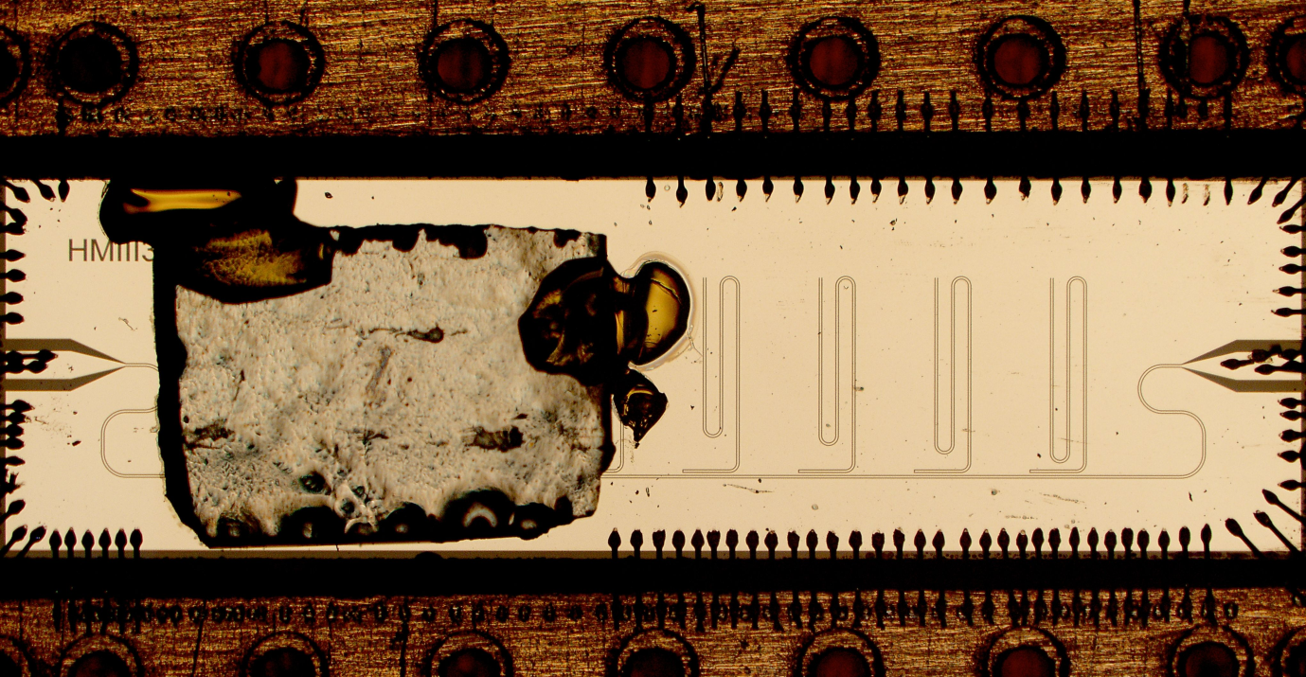
High Sensitivity EPR with Superconducting Microresonators DMR 0819860 IRG-D: H. Malissa,¹ D.I. Schuster, ² A.M. Tyryshkin,¹ A.A. Houck,¹ and S.A. Lyon¹ ¹Princeton Center for Complex Materials (PCCM), ²University of Chicago
Electron paramagnetic resonance (EPR) is commonly used to manipulate and measure the magnetic moments (or spins) of electrons. IRG-D researchers at the Princeton Center for Complex Materials (PCCM) have demonstrated a 100 fold improvement in sensitivity to the electrons’ spins by combining long-coherence donor electrons in isotopically enriched silicon with superconducting Nb microresonators.¹ The PCCM researchers have previously shown that these donor impurities, each binding one electron, exhibit exceptionally long quantum coherence. The microresonators allow them to work with much smaller numbers of electrons, especially electrons near surfaces where they can be employed as qubits in quantum devices.
1. H. Malissa, et al., Rev. Sci. Instrum. 84, 25116 (2013)
2. A. Tyryshkin, et al., Nature Mater. 11, 143 (2012).
Fig. 1 Photograph of a group of superconducting microresonators (the S-shaped patterns on the right half of the device) etched into a Nb film. A piece of silicon with a thin, isotopically enriched layer containing phosphorus donor impurities is mounted over some of the resonators on the left. The microwave magnetic field extends about a thousandth of an inch above the resonators, thus probing only the thin isotopically enriched silicon layer

