Slide 1
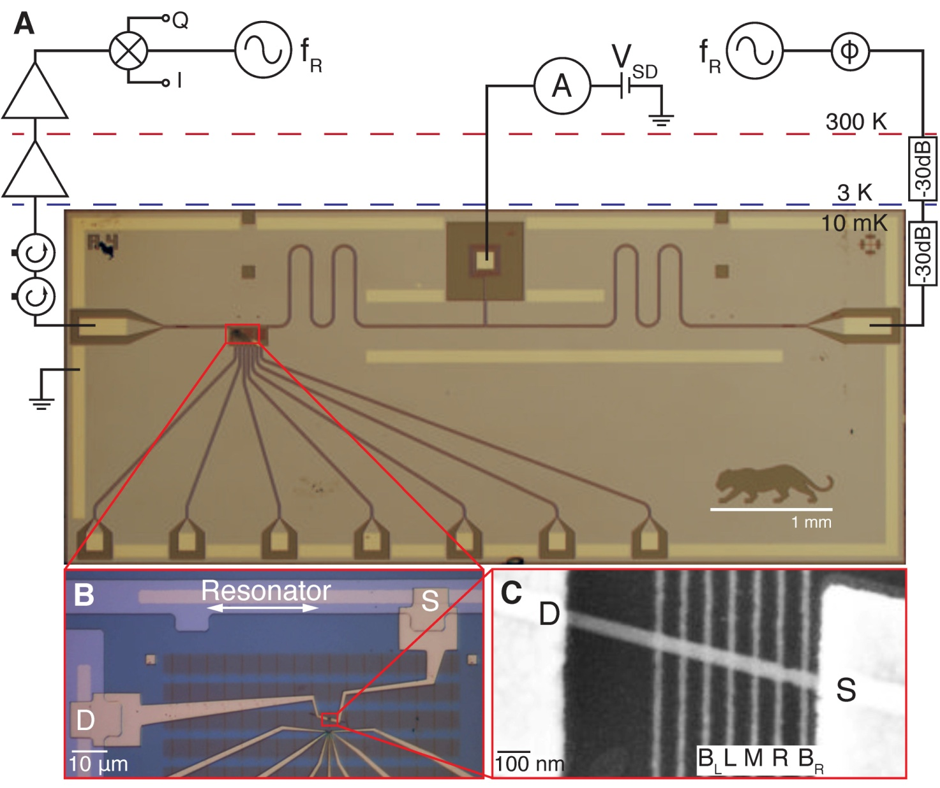
Coupling a Single Electron Spin to a Microwave Cavity
Princeton Center for Complex Materials (PCCM) (DMR 0819860)
IRG-D: K. D. Petersson¹, L. W. McFaul¹, M. D. Schroer¹, J. M. Taylor², A. A. Houck¹, J. R. Petta¹,
¹Princeton University, ²Joint Quantum Institute
IRG-D researchers at Princeton University have combined superconducting qubit technology with single spin devices, demonstrating that the microwave field of a superconducting resonator is sensitive to the spin of a single electron. The device may allow two spatially separated electron spins to be coupled, resulting in quantum entanglement.
K. D. Petersson, L. W. McFaul, J. M. Taylor, A. A. Houck, J. R. Petta, Nature 490, 380 (2012).
Fig. 1 A Optical image of the device used to couple a single spin qubit to a photonic cavity. B A nanowire is electrically connected to the resonator. C Two electrons are trapped in the nanowire and they respond to the electric field in a spin-dependent manner.
Partial support from ARO, DARPA, and the Packard Foundation

