Slide 1
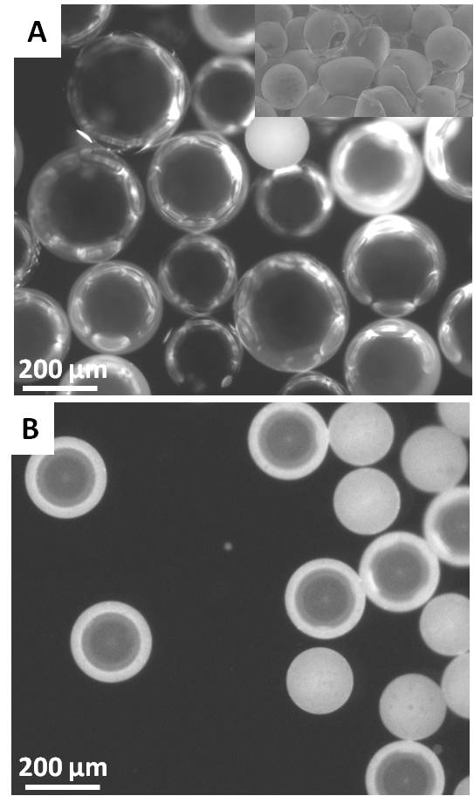
Microfluidics for block polymer shells (DMR 0819860) SEED :H.A. Stone, R.A. Register and Janine Nunes Princeton Center for Complex Materials (PCCM)
We utilized microfluidic methods to investigate the role of geometric structures, e.g. thin spherical block copolymer shells, in the microphase separation in block copolymer thin films. The shells are comprised of the triblock copolymer styrene-isoprene-styrene (SIS). For air-in-oil-in-water emulsions, microfluidic devices with two consecutive flow-focusing junctions were used to generate air bubble-containing droplets of a solution of the SIS triblock copolymer in toluene in an aqueous solution of poly(vinyl alcohol) (PVA). The toluene was allowed to evaporate, leaving thin spherical shells of SIS triblock copolymer suspended in PVA solution (Fig. 1). The use of microfluidic methods to generate such particles facilitates the straightforward modification of the inner phase composition to study the effect of different chemistries of the core on block copolymer microphase separation, as well as the effect on the mechanical stability of the shell.
Figure 1 (A) Fluorescence image of an air-in-oil-in-water emulsion. The inner phase is air, the middle phase is composed of styrene-isoprene-styrene triblock copolymer, and the outer phase is water. (B) Fluorescence image of a water-in-oil-in-water double emulsion.

