Slide 1
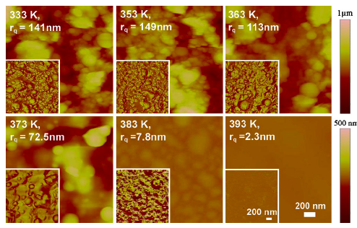
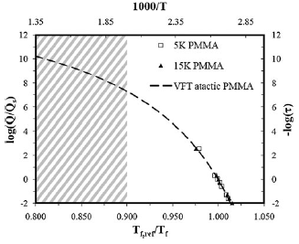
Nanostructured Stable Thin Polymer Films (DMR-0819860) SEED: R. D. Priestley and C.B. Arnold Princeton Center for Complex Materials (PCCM)
PCCM researchers are able to form thermally and kinetically stable polymer thin films with an enhanced glass transition temperature (T_{g}) and high temperature kinetic stability against the glass-to-liquid transition via laser deposition. The films are formed by the buildup of nearly spherical nanoglobubles (right). The graph (bottom right) demonstrates that high cooling rates (Q) are achieved during the deposition process, resulting in elevated T_{g}s. The image (right) illustrates the stability of the nanostructured morphology, against coalescence, at temperatures well above the normal T_{g} of 350 K. In addition, the nanostructured morphology is formed during the initial stages of deposition (bottom), as globules are observed after 1 and 5 min of deposition.
Guo et al., Nature Materials, DOI:10.1038/nmat3234 (2012)
Shepard et al., App Phy A, DOI:10.1007/s00339-012-7151-8 (2013)

