Slide 1
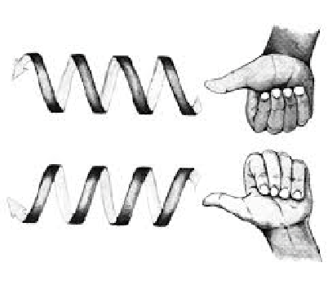
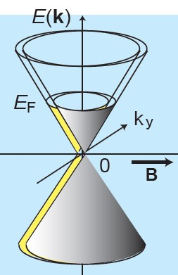
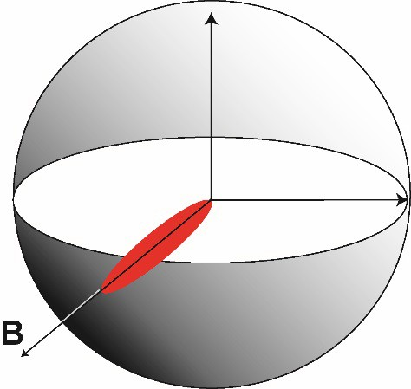
The chiral anomaly in a Dirac semimetal
IRG1: Princeton Center for Complex Materials (DMR-1420541)
J. Xiong, S. Kushwaha, T. Liang, J. Krizan, W. Wang, M. Hirschberger, R. J. Cava and N. P. Ong
B
^{C} Axial
plume
A
(A) The handedness inherent in massless particles
(B) The massless Dirac cone splits into 2 Weyl cones in a magnetic field B
(C) The axial plume observed in Na₃Bi
The notion of handedness or chirality (Greek for “hand”) is ubiquitous in chemistry, biology and physics. In quantum field theory, all massless particles (e.g. neutrinos) are chiral. The left- and right-handed populations are independent and never mix (Fig. A). However, inter-conversion occurs once electromagnetic fields are turned on. The field-induced mixing -- known as the chiral anomaly – produces an “axial current”. The effect was predicted in 1983 to occur in crystals. This was recently confirmed in the Dirac semimetal Na₃Bi [1]. In Na₃Bi, the crossing of two electronic bands (based on Bi6p and Na3s orbitals) leads to states well-described by the massless Dirac equation. In a magnetic field the Dirac cone separates into two Weyl cones of opposite chirality (Fig. B). Xiong et al. [1] showed that, when an electric field is applied parallel to a magnetic field, mixing between the Weyl states leads to strong enhancement of the charge current. Moreover, the enhanced current (dubbed the axial plume) is steerable by the magnetic field (Fig. C). Predictions of the chiral anomaly can now be tested in the lab. in regimes inaccessible to particle accelerators (e.g. in intense magnetic fields). Further experiments may lead to novel electronic applications.
1. “Evidence for the chiral anomaly in the Dirac semimetal Na₃Bi,” J. Xiong et al., Science Online 3 September 2015, DOI: 10.1126/science.aac6089
Research supported by the US National Science Foundation, the Army Research Office and the Moore Foundation.

