Slide 1
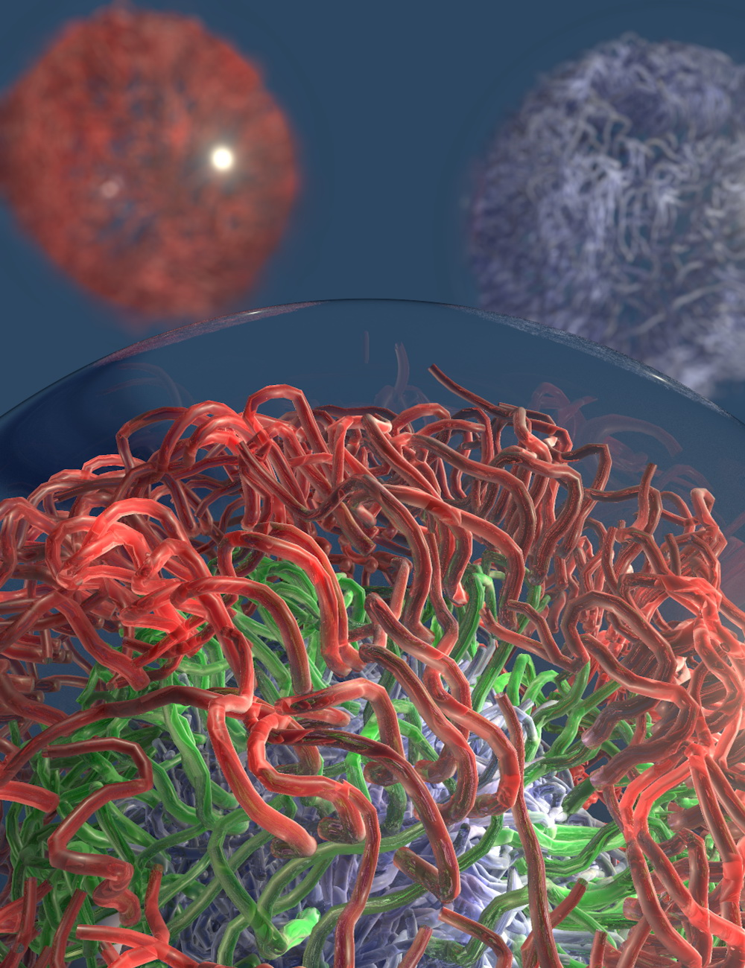
Programming Molecular Self-Assembly of Intrinsically Disordered Proteins
New model systems of liquid protein assemblies offer insights into naturally-occurring counterparts
Scientists at Duke University, The University of North Carolina at Chapel Hill, and The University of New Mexico have engineered systems to program the self-assembly of disordered proteins into a variety of structures that resemble those found within cells.
In their recent publication in Nature Chemistry, Triangle MRSEC investigators Gabriel López, Ashutosh Chilkoti, Michael Rubinstein, Nick Carroll and graduate fellow Joseph Simon created systems for studying the phase behavior of archetypal disordered proteins and programming their self-assembly into protein-rich liquid coacervates. They demonstrate the use of theoretical analyses to interpret protein phase behavior and rationally design protein assemblies within microscopic water droplets that include layered, mixed, and size-controlled coacervates akin to those found in the interior of cells.
These new models of liquid coacervates are exciting tools for studying native intracellular coacervate assemblies and hold promise as building blocks for exciting biomedical applications.
“Programming Molecular Self-Assembly of Intrinsically Disordered Proteins Containing Sequences of Low-Complexity,” Joseph R. Simon, Nick J. Carroll, Michael Rubinstein, Ashutosh Chilkoti, and Gabriel P. López. Nature Chemistry, Jan, 30, 2017.
NSF RT-MRSEC DMR-1121107

