Slide 1
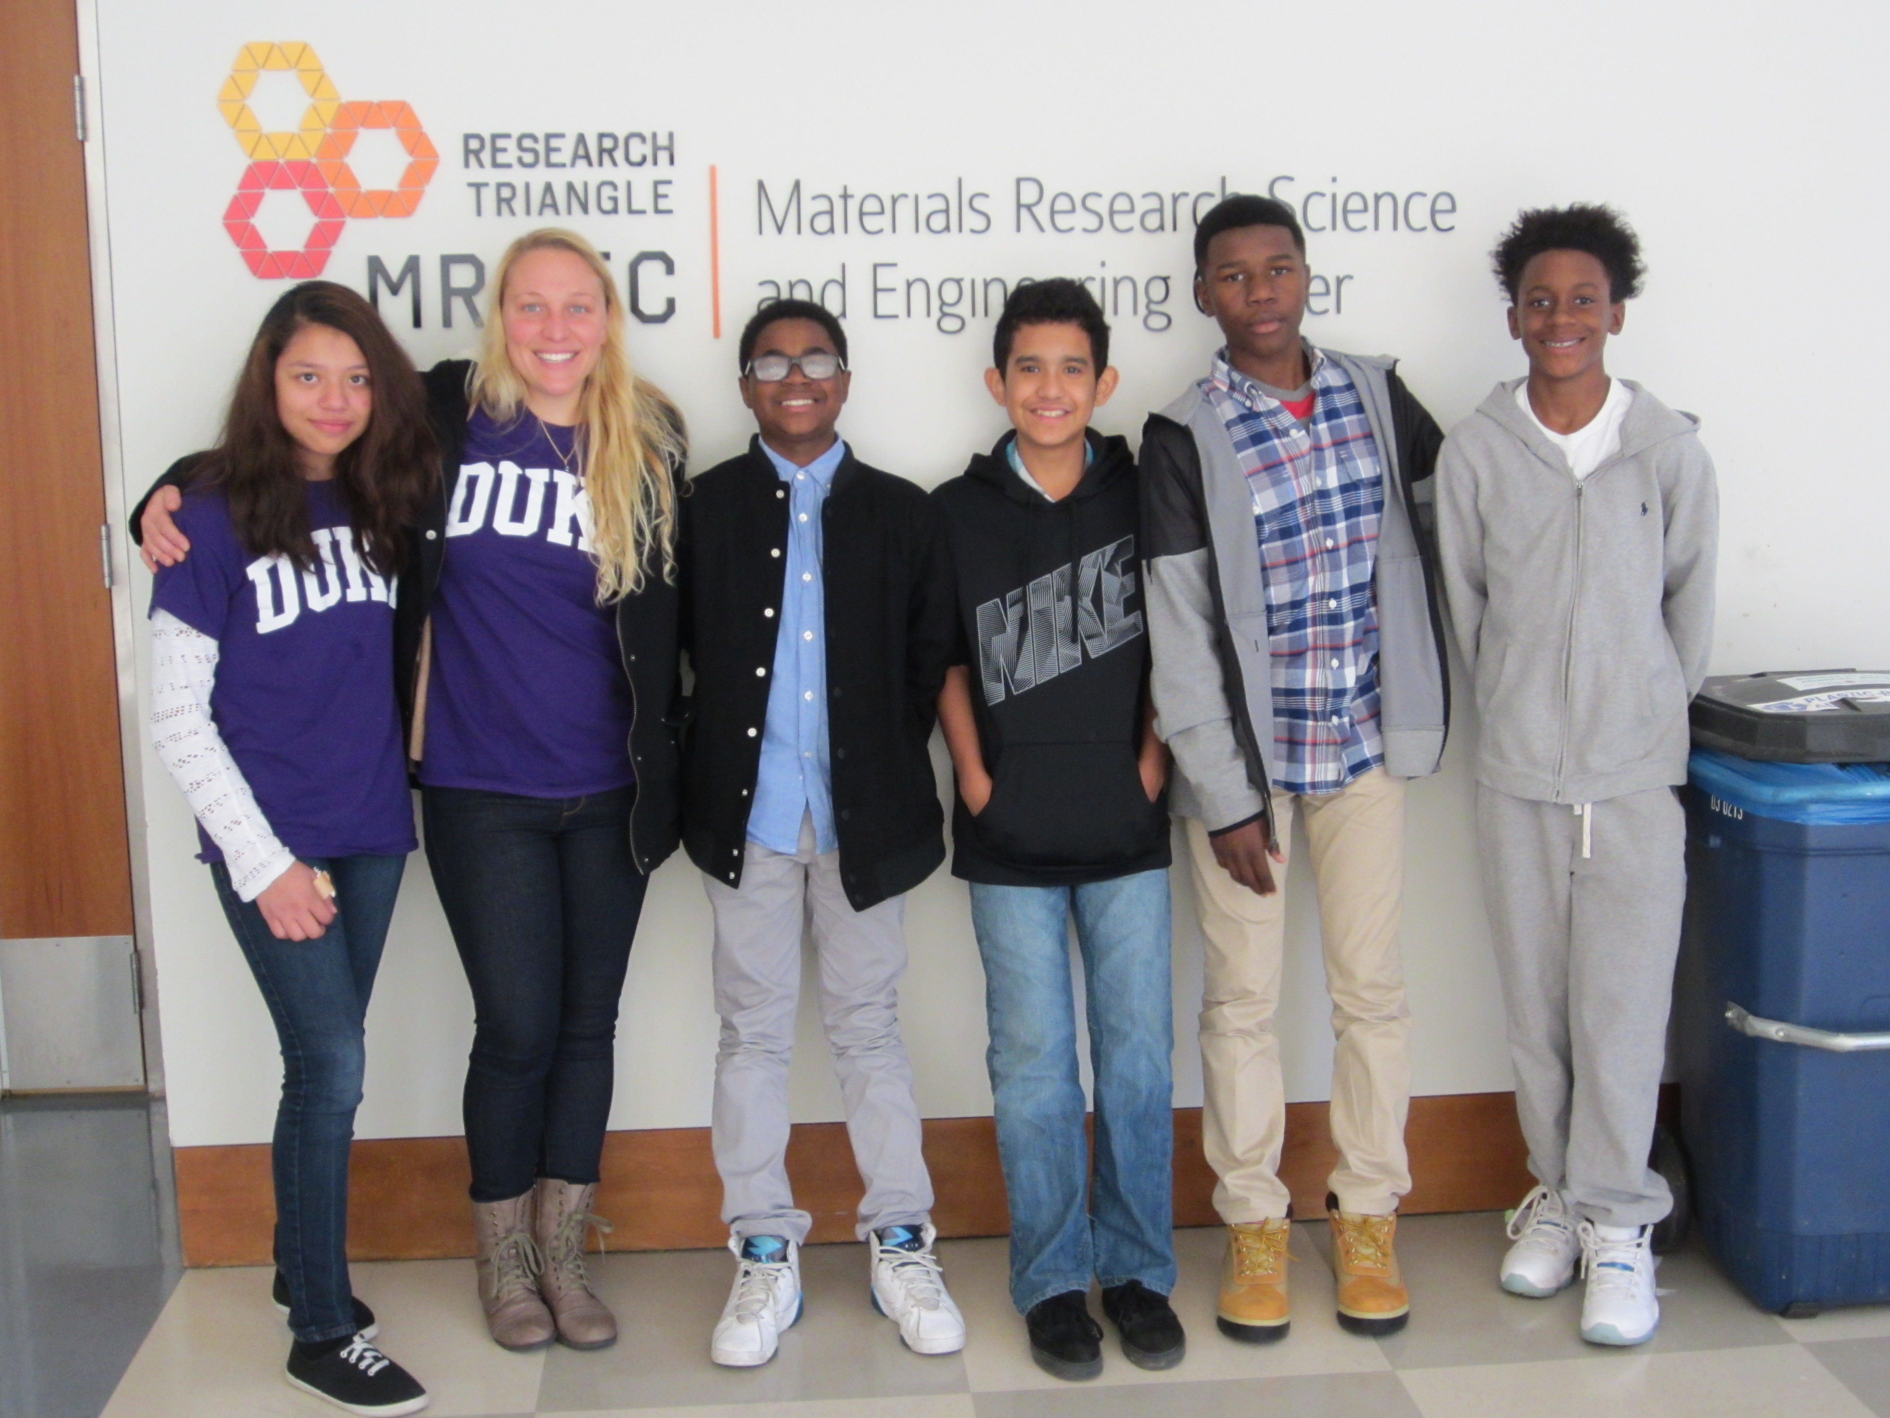
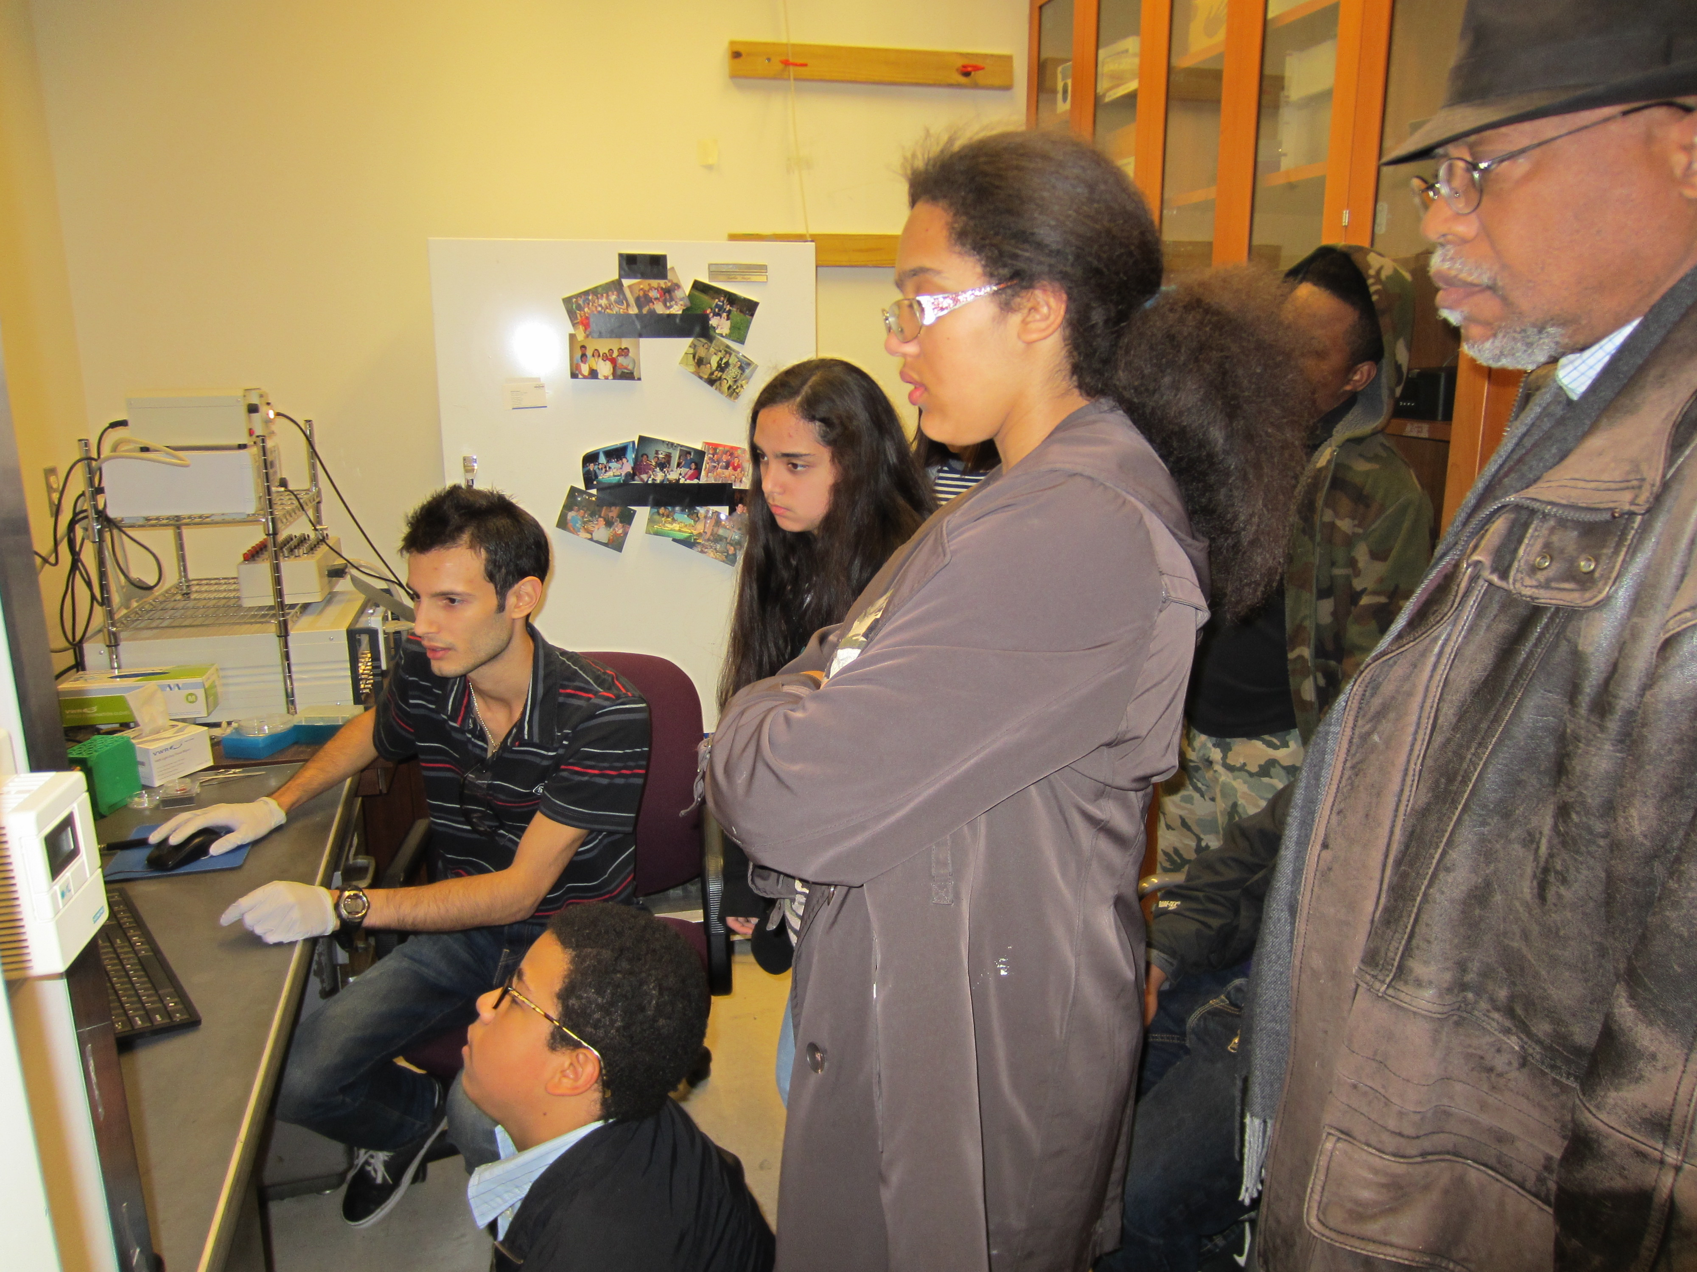
SENSOR Saturday Academy
The Student Engineers Network, Strengthening Opportunities in Research (SENSOR) Saturday Academy is an outreach program that partnered with Research Triangle MRSEC beginning in 2015 to engage 8th grade students from underrepresented minority groups enrolled in Durham County Public Schools. It is a hands-on education program designed to encourage careers in science and engineering by engaging 8th grade underrepresented minority students in materials science and water quality testing. The goals of the program are to introduce students to careers in engineering and research, to teach engineering design by applying sensors to water quality testing, and to encourage the pursuit of advanced degrees in science and engineering.
RT-MRSEC’s Education Director, Adrienne Stiff-Roberts, serves as Director and Instructor of the academy, which engages a single cohort of 24 URM 8th graders in science and engineering activities throughout the academic year (13 Saturdays). RT-MRSEC contributes in three important areas: i) RT-MRSEC faculty and postdocs discuss current research areas and paths to attaining a PhD; ii) RT-MRSEC graduate students provide lab tours to introduce research and equipment; and iii) RT-MRSEC graduate students participate in a panel discussion about college preparation and STEM careers.

