Slide 1
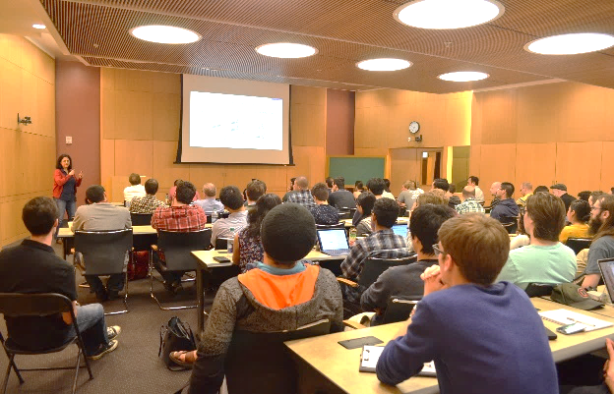
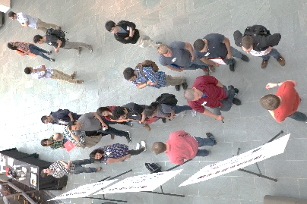
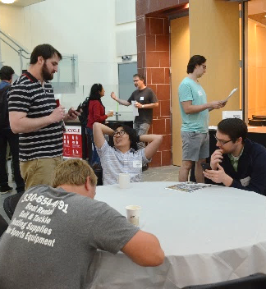
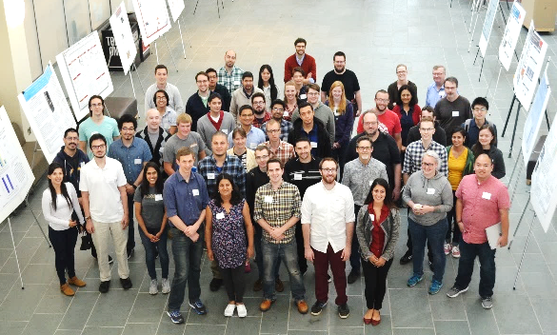
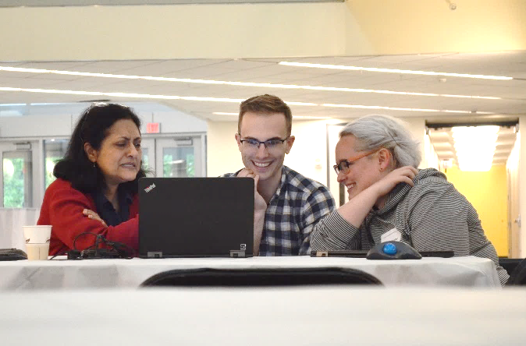
Physics of Emergent Materials Workshop (POEM)
A workshop organized by students and for students: May 23rd-25th, 2017
The CEM Internal Advisory Council, a grassroots committee of students and postdoctoral researchers, created POEM to inform the Center’s direction and improve the educational and research experiences of CEM students.
POEM was composed of tutorials by faculty, student talks, tours, and poster sessions.
The workshop provided extensive opportunities for interaction between on- and offsite CEM students, students from the New Mexico Highlands University PREM, and CEM faculty.
It was also a platform for CEM faculty to exchange innovative ideas and further the research direction of the MRSEC.
R. Page and J. Katoch, Ohio State University

