Slide 1
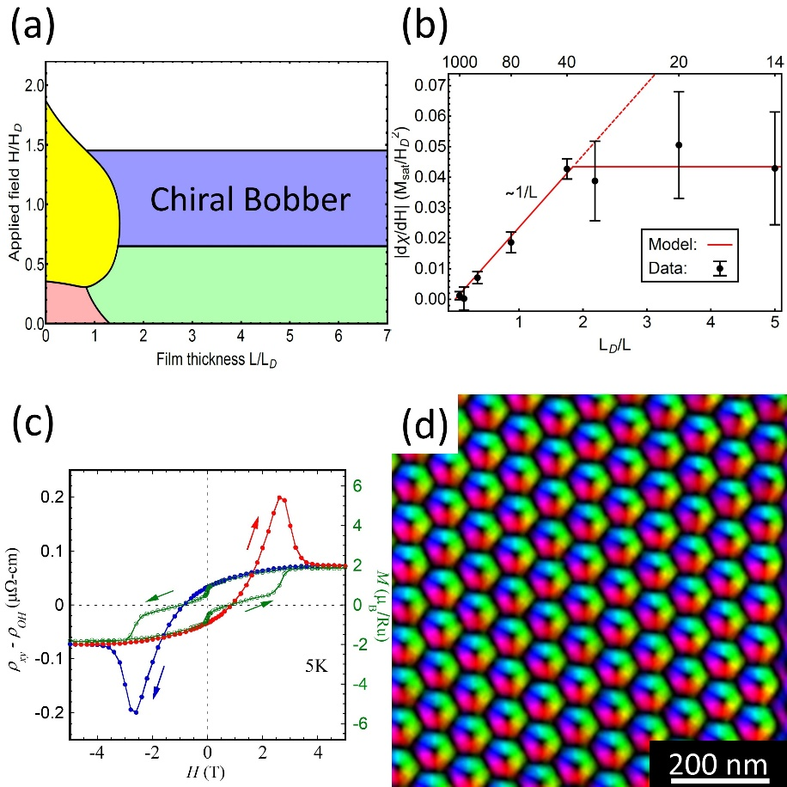
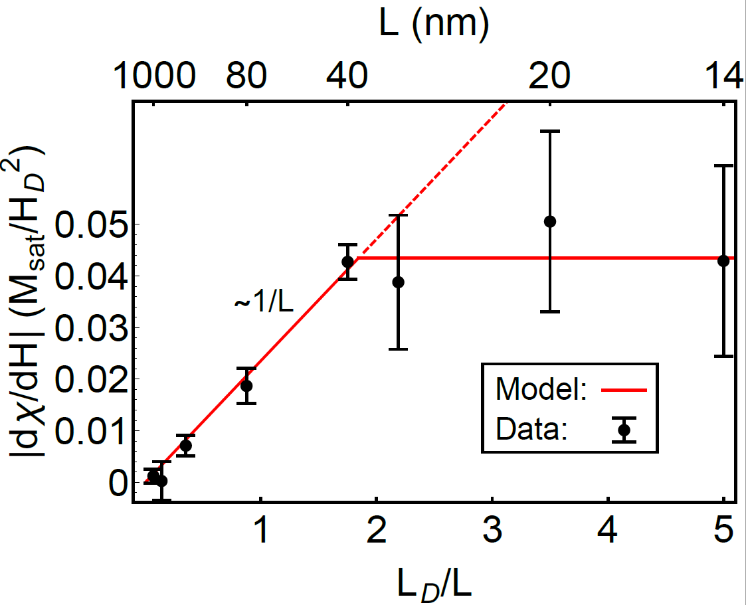
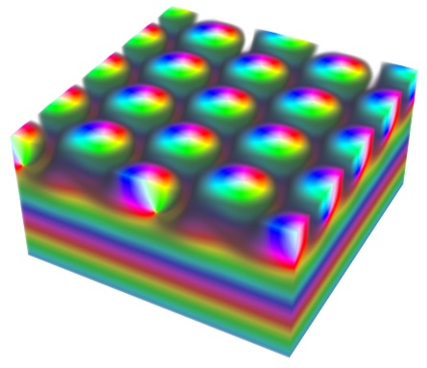
Proto-IRG: Spin Textures in Chiral Magnetic Materials
(b)
Experimental evidence in MBE-grown FeGe thin films for “chiral bobbers”, topological spin texture that exist near an interface.
Theoretical modeling predicts stable chiral bobbers in materials with both bulk and interfacial DMI.
Lorentz TEM imaging of skyrmions in FeGe
thinned crystals
Topological Hall effect measurements of skyrmions in FeGe thin films and novel oxide heterostructures of SrIrO₃/SrRuO_{3.}
Development of microwave absorption
spectroscopy to probe skyrmion materials.
This CEM-nucleated team was awarded a major DARPA grant in February 2018 to work on skyrmion materials
A. Ahmed, J. Rowland, B. Esser, S. Dunsiger, D. McComb,
M. Randeria, R. Kawakami, Phys. Rev. Materials, 2, 041401 (2018).

