Slide 1
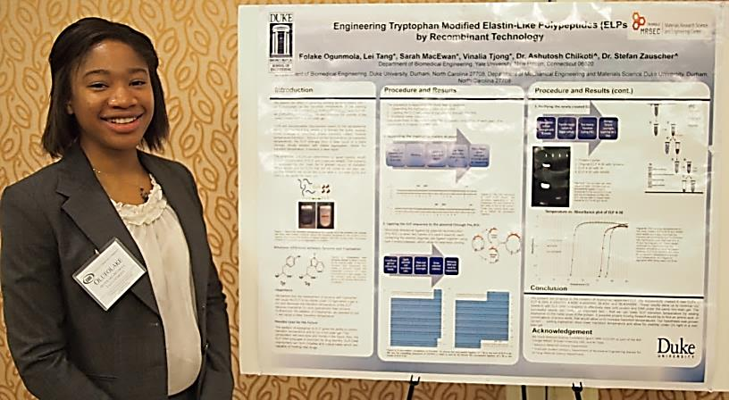
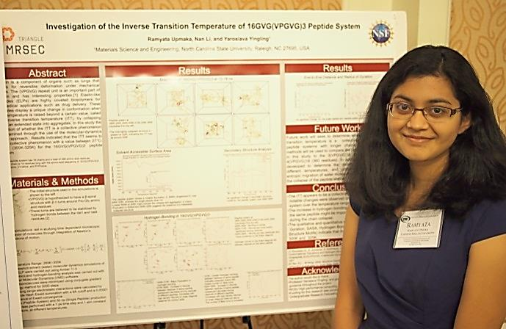
Supporting STEM Education and Professional Careers through the REU Program
The long term goals of the Triangle MRSEC REU program are to maximize opportunities for undergraduate involvement MRSEC research, recruit diverse undergraduate students from across the country, and encourage and support future careers in materials science and engineering. Our 2012 class of REU students represented a diverse group of undergraduates with 50% females and 75% underrepresented minorities.
After the 2012 REU program, informal conversations founds that the students were satisfied with their research experience overall and were more likely to pursue a degree in materials science.
We have maintained ongoing interactions with these REU students to assess student outcomes. One REU enrolled in the PhD program at Duke in Spring 2013. Three additional REUs are applying to graduate school at Duke for Fall 2013. One excellent REU is reapplying to the MRSEC REU program for Summer 2013. One REU has co-authored a manuscript (Anal. Chem.) and
another will be a co-author on a future manuscript. Two REUs, one from Duke and one from NCSU, presented posters at the Council on Undergraduate Research (CUR) REU conference in Arlington, VA (Oct. 21-22nd, 2012). These outcomes confirm that the Triangle MRSEC REU program serves as an influential stepping stone for supporting future graduate school and professional careers in STEM fields, particularly materials science and engineering.
Notes:
The long term goal of the ΔMRSEC outreach program is to develop sustained partnerships with G5-12 schools, teachers, and students, to bring STEM concepts into the classroom, and increase the diversity and enrollment of domestic students in STEM degree programs. ΔMRSEC has made significant progress in this direction by partnering with the North Carolina Central University (NCCU) Women’s Center which is in its third year of a program with Shepard Middle School in Durham, NC. This program, entitled Women Inspiring Learning Momentum (W.I.L.L.), is designed to encourage middle school girls to pursue STEM careers, and pairs girls from Shepard Middle School with NCCU female undergraduate students and working STEM professionals, for a six week Saturday experience. During Saturdays in the 2012 spring semester, middle school students came to NCCU's campus, to participate in mentoring sessions, academic enrichment activities, hands-on scientific experiments, a field trip, and seminars focused on breaking the barriers faced by women in the sciences. Two ΔMRSEC undergraduates helped to plan the 2012 curriculum and to chair the experiments committee. ΔMRSEC fellow Kallon served as a graduate student mentor to two of the 20 WI.L.L. participants. ΔMRSEC Co-Director Hall and Investigator Taylor, were two of the professional mentors recruited to speak to the middle school girls (Fig. 2).

