Slide 1
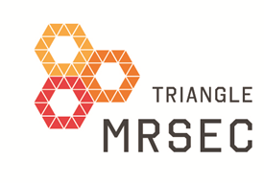
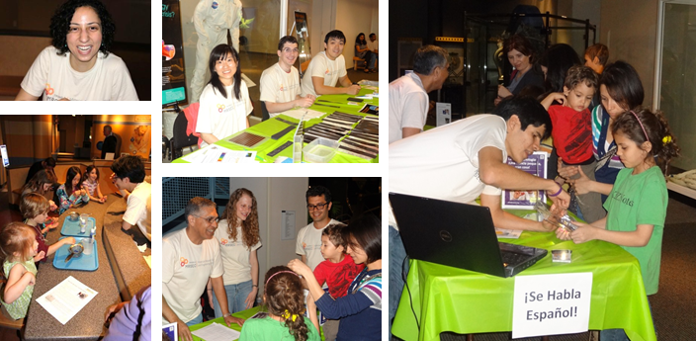
DUKE | NCCU | NCSU | UNC-CH
Nanodays at the North Carolina
Museum of Life and Science
Stefan Zauscher, Education Director, Triangle MRSEC
Duke University
ΔMRSEC has partnered with the NC Museum of Life and Science (MLS) in Durham to leverage MLS’s projects in the Nanoscale Informal Science Education Network (NISE Net). On March 24, 2012, ΔMRSEC Fellows and Investigators participated in the MLS NanoDays and reached hundreds of children and adults by presenting ΔMRSEC relevant experiments. Enabled by native Spanish speakers in the ΔMRSEC, some experiments were presented in Spanish. The activities found enthusiastic reception by visitors, fellows, and MLS staff alike, and form the foundation for additional outreach activities with MLS.
Visit ΔMRSEC at http://mrsec.duke.edu
NSF DMR 1121107
Notes:
Nanodays at the Museum of Life and Science in Durham
A major objective of the ΔMRSEC program in public education is to provide informal educational opportunities about soft matter and nano materials science to the broader public. To this end, ΔMRSEC has partnered with the NC Museum of Life and Science (MLS) in Durham. Through the MLS, which serves as ΔMRSEC’s principle outreach partner, ΔMRSEC can leverage MLS’s projects in the Nanoscale Informal Science Education Network (NISE Net). On March 24, 2012, seventeen ΔMRSEC Fellows, ΔMRSEC Director Lopez, executive Director Boutaud, and Education Director Zauscher, participated in the MLS NanoDays (March 24, 2012). ΔMRSEC was able to reach hundreds of children and adults by presenting ΔMRSEC relevant experiments from the 2012 NanoDays kits. The ΔMRSEC participants were trained by museum staff under leadership of Brad Herring (MLS). Enabled by native Spanish speakers in the ΔMRSEC, some NanoDay kits were presented in Spanish. The activities found enthusiastic reception by Fellows, NCLMS staff, and visitors alike, and form the foundation for additional outreach activities.
Supported by the NSF’s Research Triangle MRSEC DMR-1121107.

