Slide 1
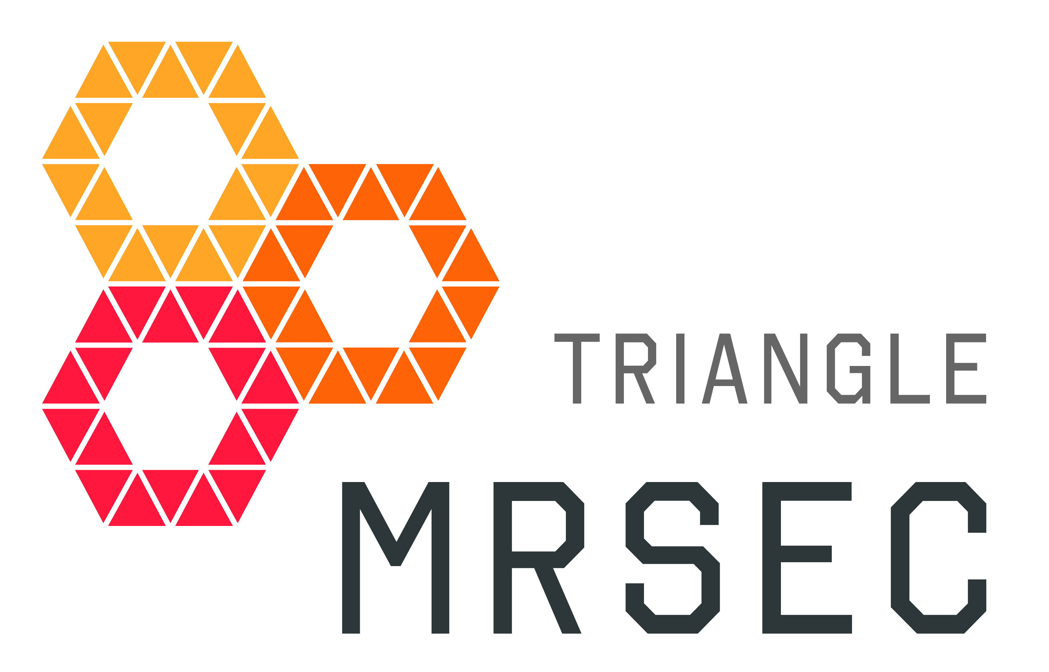
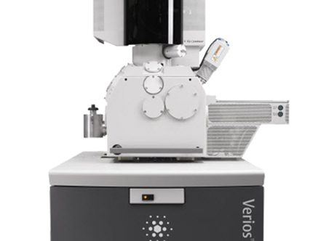
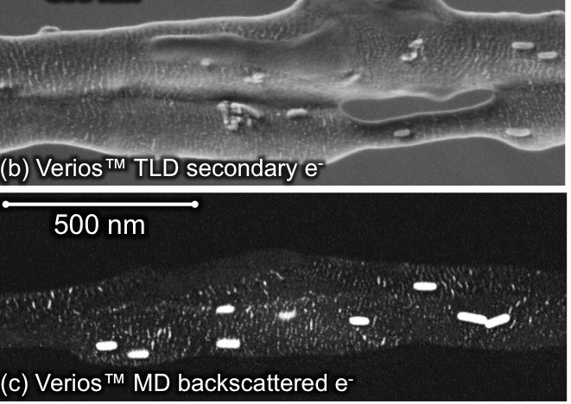
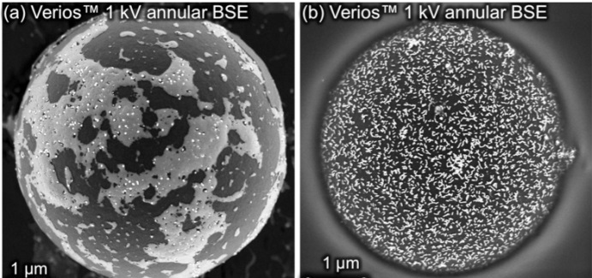
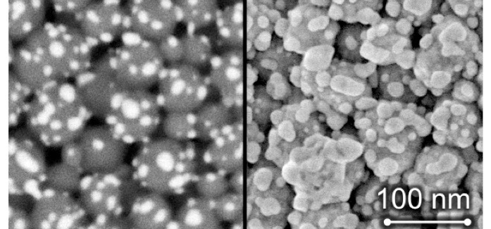
Research Triangle Acquires Extreme Resolution Scanning Electron Microscope
FEI Verios FESEM/STEM
0.6 nm resolution
In collaboration with the Triangle MRSEC, a team from NC State University was awarded a grant from the NSF-MRI program for the purchase of extreme-resolution scanning electron microscope (/www.nsf.gov/awardsearch/showAward?AWD_ID=1337694 ). The state-of-the-art instrument will serve the greater Research Triangle community for research and education, and will be housed at NC State’s Analytical Instrumentation Facility. The Varios extreme-resolution FESEM has resolving power approaching atomic dimensions. Its low energy probe allows researchers to explore soft matter substances like plastics, natural fibers, and cells. These capabilities will enhance materials research at Triangle MRSEC, including nanoparticle composites, colloidal assemblies, and DNA-mediated organic-inorganic assemblies. The instrument will also create new outreach opportunities to inspire future STEM students.
High resolution and high contrast images of particles and soft matter

