Slide 1
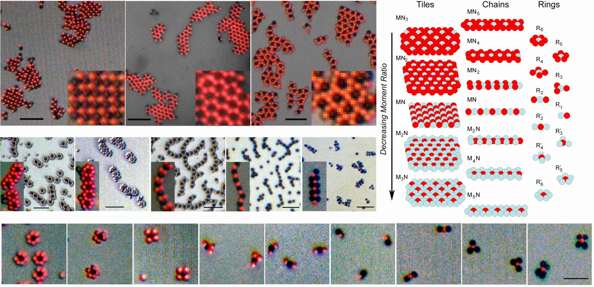
DUKE | NCCU | NCSU | UNC-CH
Binary Colloidal Structures Assembled through Ising Interactions
K. Khalil,¹ A. Sagastegui,¹ Y. Li,² M. A. Tahir,¹ J. E. S. Socolar,³ B. J. Wiley,⁴ and B. B. Yellen^{1, 2}
¹Depts. of Mechanical Engineering and Materials Science,³Physics and ⁴Chemistry, Duke University
²University of Michigan – Shanghai Jiao Tong University Joint Institute, Shanghai Jiao Tong University
ΔMRSEC researchers have developed a highly tunable strategy to coax micron-size particles to assemble into a wide variety of two-dimensional structures. A mixture of magnetic and non-magnetic spherical beads is immersed in a ferrofluid and confined between two plates. The structures are selected by controlling the relative concentrations of the two bead types and the magnetic susceptibility of the ferrofluid. Control of the formation of such structures provides a new path to the fabrication of complex materials.
Visit ΔMRSEC at http://mrsec.duke.edu
NSF DMR 1121107
Nature Comm. 3, 794 (2012)
Notes:
Assembling microscopic particles into macroscopic structures can open new pathways for producing complex materials that cannot be produced by lithographic methods. Although several methods for assembling colloidal particles exist, including controlled drying, ionic interactions, and dipolar interactions, a general pathway for producing a wider variety of structures remains a fundamental challenge. Here a versatile colloidal assembly system is demonstrated in which the design rules can be tuned to yield over 20 different pre-programmed structures, including kagome, honeycomb, square tiles, and various chain and ring configurations. The assembled structures are tuned by controlling the relative concentrations and interaction strengths between spherical magnetic and non-magnetic beads, which behave as paramagnetic or diamagnetic dipoles when immersed in a ferrofluid. A comparison of our experimental observations with potential energy calculations suggest that the lowest energy configuration within binary mixtures is determined entirely by two parameters, namely the relative dipole strengths and their relative concentrations. The enhanced flexibility enabled by tunable Ising interactions within colloidal particle systems makes this work relevant not only to the exploration of fundamental problems in materials science and soft matter, but also to the bottom-up fabrication of photonic, phononic, and magnetic devices.
Reference:
Binary Colloidal Structures Assembled through Ising Interactions
Nature Communications 3, 794 (2012)
Karim Khalil*¹, Amanda Sagastegui*¹, Yu Li², Mukarram A. Tahir¹, Joshua E. S. Socolar³, Benjamin J. Wiley⁴, and Benjamin B. Yellen^{1, 2}
¹Duke University, Department of Mechanical Engineering and Materials Science, Center for Biologically Inspired Materials and Material Systems, PO Box 90300 Hudson Hall, Durham, NC 27708, Corresponding author: yellen@duke.edu, * denotes co-first authors.
³Duke University, Department of Physics
⁴Duke University, Department of Chemistry
²University of Michigan – Shanghai Jiao Tong University Joint Institute, Shanghai Jiao Tong University, Shanghai, China.
Acknowledgement:
The authors are thankful for support from the Research Triangle MRSEC funded by National Science Foundation, DMR-1121107, and foreign young scholars grant funded by National Science Foundation of China, 51150110161.

