Slide 1
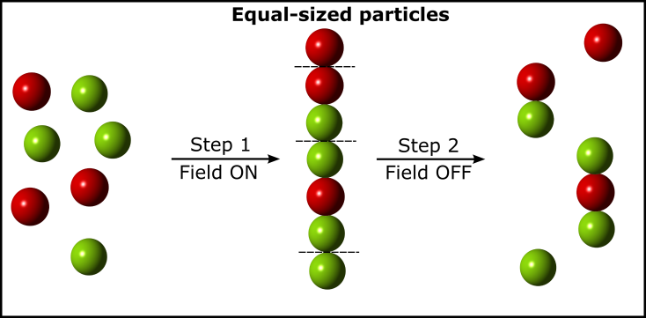
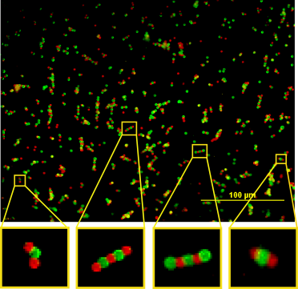
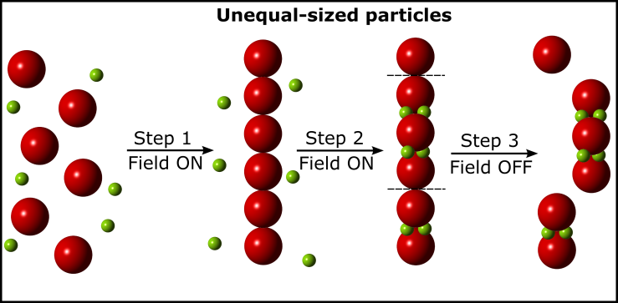
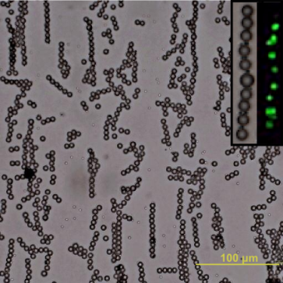
DUKE | NCCU | NCSU | UNC-CH
Co-Assembly of Oppositely Charged Particles into Linear Clusters and Chains of Controllable Length
Bhuvnesh Bharti¹, Gerhard H. Findenegg² and Orlin D. Velev¹
¹Deptartment of Chemical and Biomolecular Engineering, North Carolina State University
²Institut für Chemie, Technische Universität Berlin, Germany
Orlin D. Velev and Bhuvnesh Bharti from ΔMRSEC in collaboration Gerhard Findenegg from TU Berlin have developed a unique method to fabricate permanent linear chains of oppositely charged microparticles.
Directed the heteroaggregation into chains by AC-electric field
Chain length distribution tuned by particle size/number ratio
Developed a unique combinatorial model for predicting chain length
Proposed a set of assembly rules for the permanent chain assembly
Can find applications in new classes of viscoelastic materials and gels with unusual properties.
Figure: Assembly steps of AC-electric field induced chaining of oppositely charged particles. Green and red spheres are the positively and negatively charged particles respectively.
Visit ΔMRSEC at http://mrsec.duke.edu
NSF DMR 1121107
Sci. Rep. (Nature) 2, 1004 (2012)
Notes:
Colloidal particles with strongly attractive interactions snap on contact and form permanent, but disordered aggregates. In contrast, AC electric fields allow directional assembly of chains or crystals from repulsive particles by dielectrophoresis (DEP), but these structures fall apart once the field is switched off. We demonstrated how well-organized, permanent clusters and chains of micron-sized particles can be assembled by applying DEP to mixtures of oppositely charged microspheres. We found that the length of the formed chains depends on size ratio as well as the number ratio of the two species, and formulated a statistical model for this assembly mechanism, which is in excellent agreement with the experimental results. The assembly rules resulting from this study form a basis for tailoring new classes of permanent supracolloidal clusters and gels.
Reference:
Co-Assembly of Oppositely Charged Particles into Linear Clusters and Chains of Controllable Length
Sci. Rep. 2, 1004 (2012)
Bhuvnesh Bharti^{1,2}, Gerhard H. Findenegg², and Orlin D. Velev¹
¹Department of Chemical and Biomolecular Engineering, North Carolina State University, Raleigh, NC 27695, USA
odvelev@ncsu.edu
Acknowledgement:
We are grateful for the financial support of this study from US-NSF via the Triangle MRSEC on Programmable Soft Matter (DMR-1121107) and from the Deutsche Forschungsgemeinschaft (DFG) in the framework of IRTG-1524.

