Slide 1


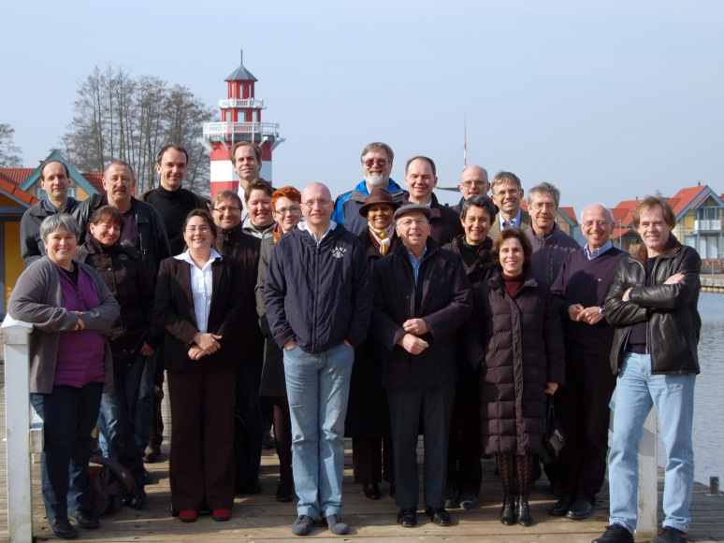
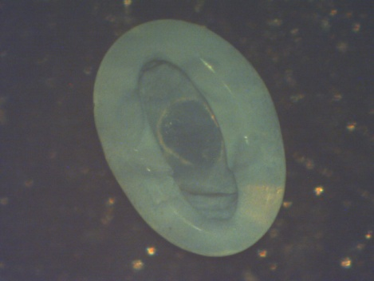
DUKE | NCCU | NCSU | UNC-CH
International Collaboration in Soft Matter
Research and Training
Orlin D. Velev, Carol K. Hall, North Carolina State University
S. Klapp, G. Findenegg, M. Gradzielski, Technical University, Berlin, Germany
The Triangle MRSEC enjoys a vibrant ongoing partnership with German researchers supported through an International Graduate Research and Training Grant (IGRTG) from the DFG. A significant component of this partnership is extended graduate student exchanges. An example of funded projects is the fundamental modeling of particle gelation by molecular dynamics simulations by Prof. Sabine Klapp (Technical Univ. - Berlin), Carol Hall and Orlin Velev. Velev is also involved in collaborations with the TU-Berlin groups of Profs. Michael Gradzielski and Gerhard Findenegg.
German-US
workshop,
Rheinsberg,
2012
Novel complex silica supraparticle assembly
large-scale
synthesis
Comparison between patchy particle
experiment (US data,
left) and theory
(German data, right)
standard
synthesis
Visit ΔMRSEC at http://mrsec.duke.edu
NSF DMR 1121107
Soft Matter 8, 1521 (2012)
Notes:
A combination of Monte-Carlo, Molecular Dynamics and Brownian Dynamics
The model displays both 1D and 2D network formation
The networks transform into one another by percolation phase transitions
Excellent correlation with experimental data
Particle assembly in droplets suspended on hydrophobic surfaces
Orlin D. Velev, Carol K. Hall, North Carolina State University*
S. Klapp, G. Findenegg, M. Gradzielski, Technical University – Berlin, Germany
* IRG-1, Triangle MRSEC, DMR-1121107.
Reference
Heiko Schmidle, ª Carol K. Hall, ^{b} Orlin D. Velev ^{b} and Sabine H. L. Klappa ª
Soft Matter, 8, 1521 (2012)
ªInstitute of Theoretical Physics, Technical University Berlin, Hardenbergstr. 36, 10623 Berlin, Germany. E-mail: schmidle@physik.tu-berlin.de
^{b}Department of Chemical and Biomolecular Engineering, North Carolina State University, Raleigh, North Carolina, 27695-7905, USA

