Slide 1
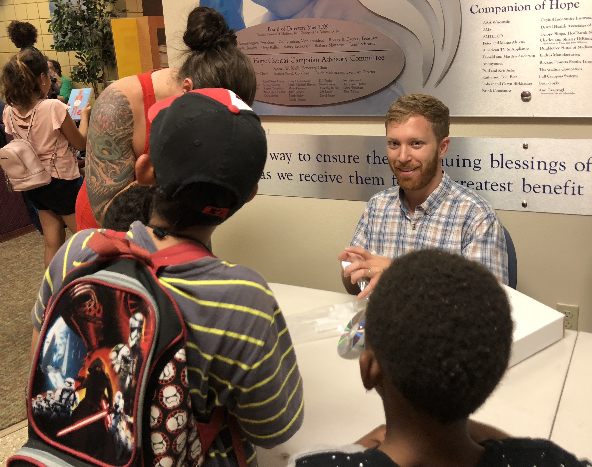
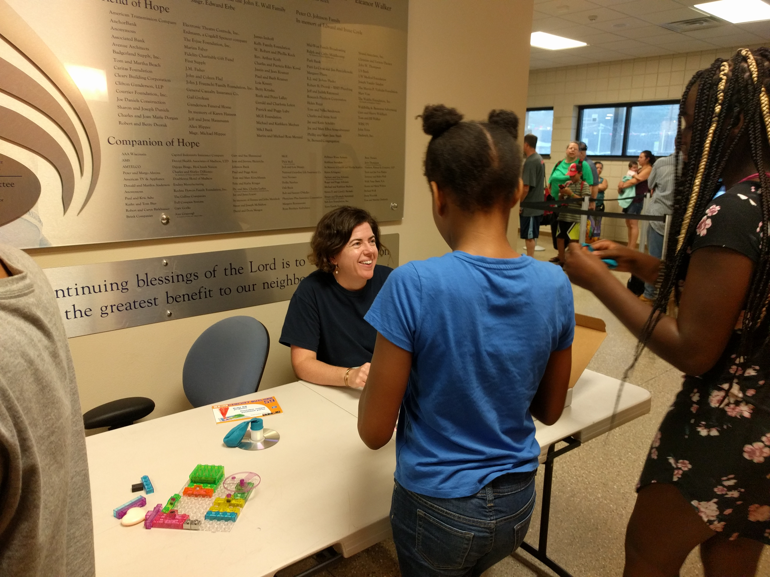
Reaching Underserved Audiences by Bringing Science to a Local Food Pantry
Materials Research Science and Engineering Centers, DMR-1720415
2019 Education and Outreach
AnneLynn Gillian-Daniel, University of Wisconsin-Madison
Not all members of our community have the time or resources to attend science outreach events. To reach some of those people, the Wisconsin MRSEC conducts its engaging, hands-on science activities to a local food pantry. Customers can wait up to 90 minutes at the food pantry, providing ample time for educational activities for kids, their parents, and other curious adult visitors.
By bringing science and engineering activities to the food pantry, the Wisconsin MRSEC forms connections with and helps inspire a new, diverse audience composed entirely of economically disadvantaged members of the community.
Wisconsin MRSEC staff build circuits with children waiting at a local food pantry (top left, bottom). Visitors to the food pantry (top right) wait for up to 90 minutes for service, so the MRSEC engages visitors with educational activities.

