Slide 1
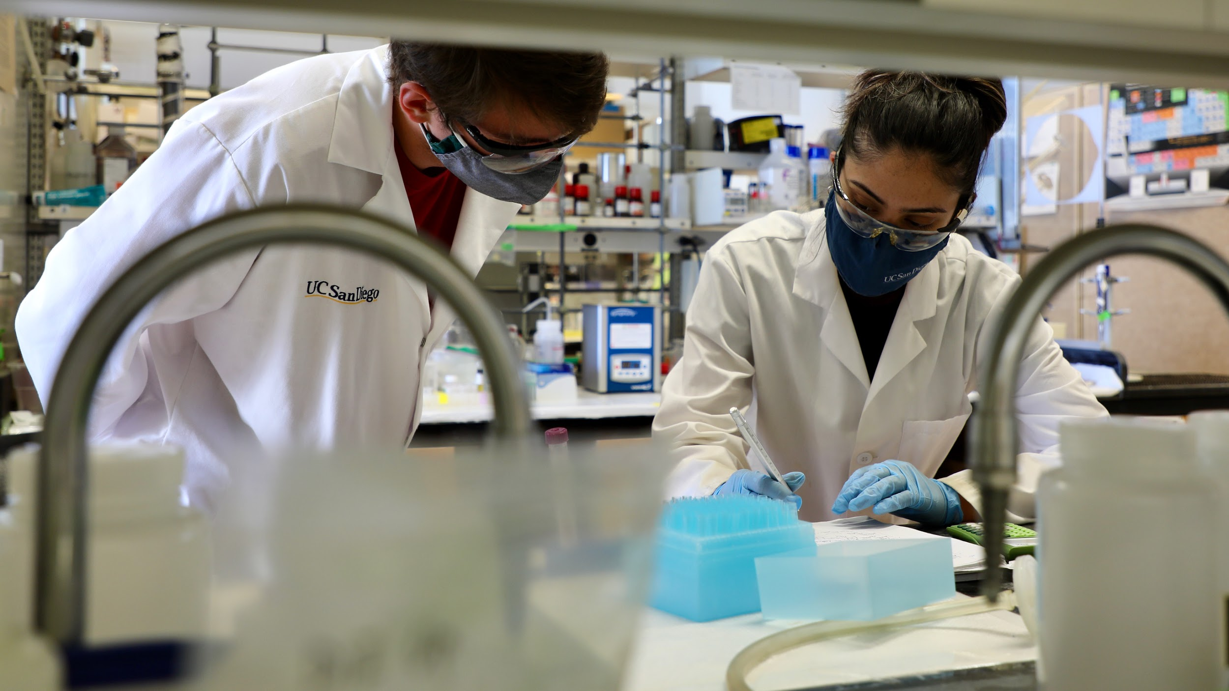
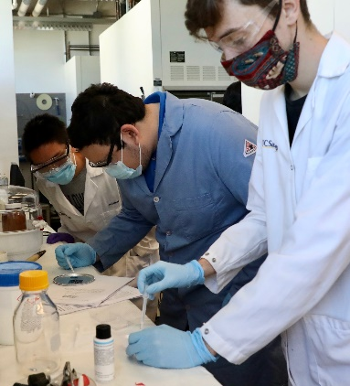
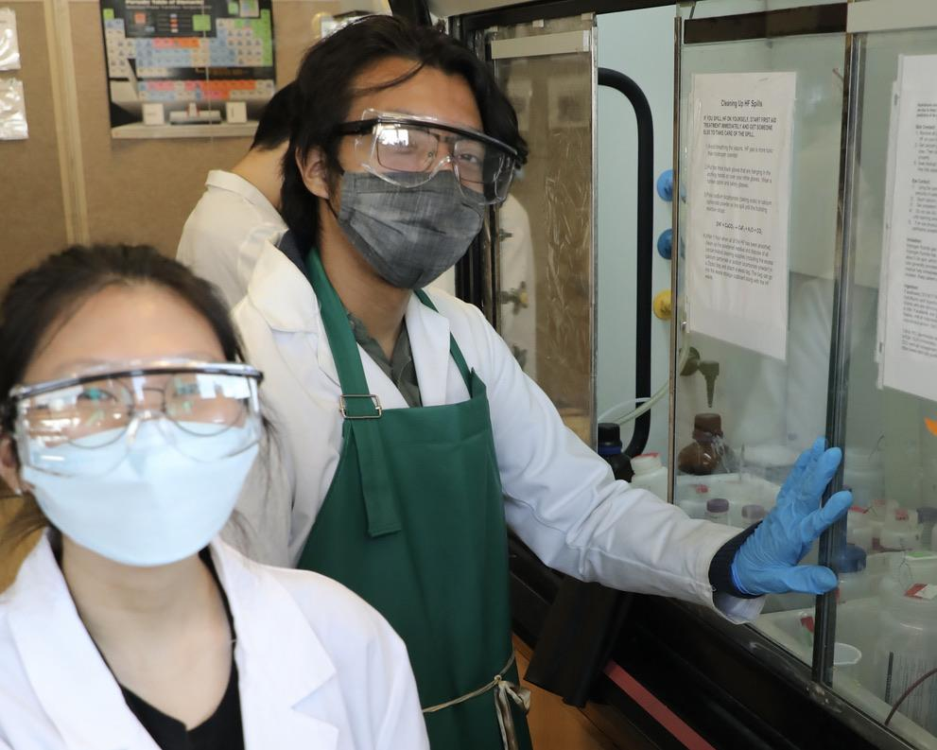
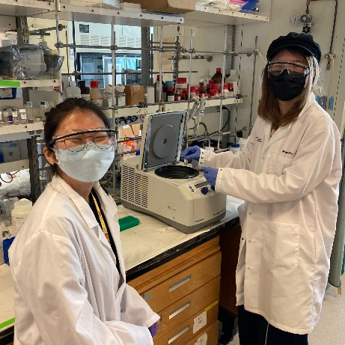
Research Immersion in Materials Science & Engineering (RIMSE) Spring Break Research Experience
Brydges, Sailor
University of California San Diego
RIMSE Spring Break Research Experience:
Filled gap in hands-on laboratory training resulting from Covid-19 pandemic.
Trained and prepared undergraduate students to enter research labs.
Recruited diverse trainees for MRSEC, REU, and other UC San Diego Summer research programs.
Notes:
Education and Human Resource Development: In response to a campus-wide initiative to prevent a surge in COVID19 infections, the Center piloted a special (in-person) RIMSE Spring Break Research Experience to encourage undergraduate students to remain on campus during the 2021 Spring Break. The program provided preparation and training for 12 students to engage in summer research opportunities, both within the MRSEC and in the larger UC San Diego research community.

