Slide 1
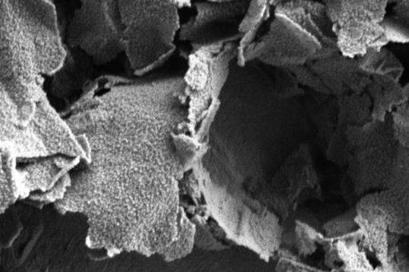
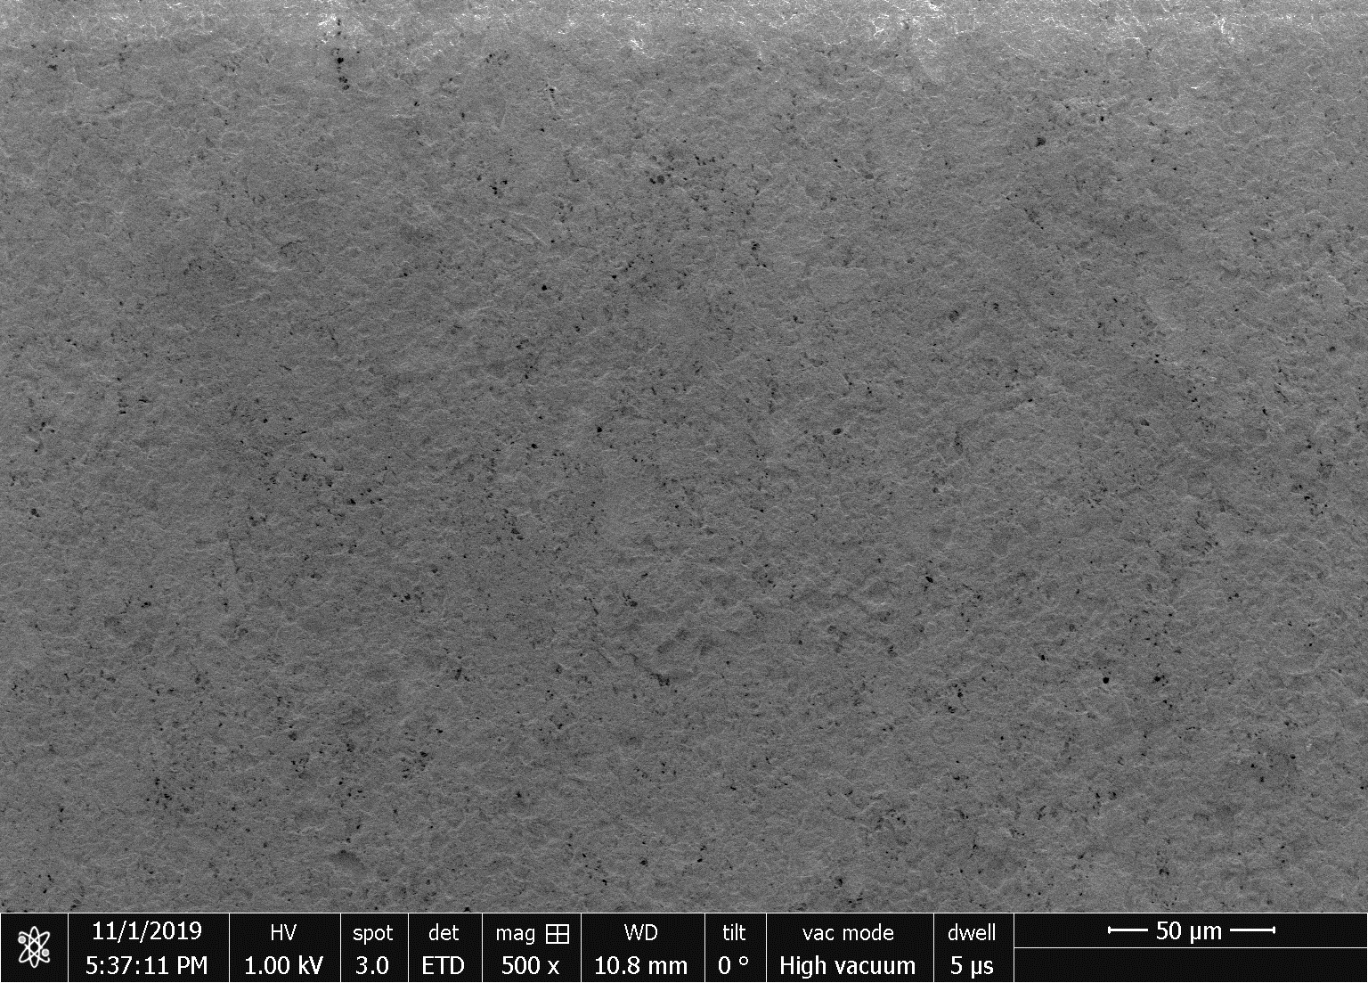
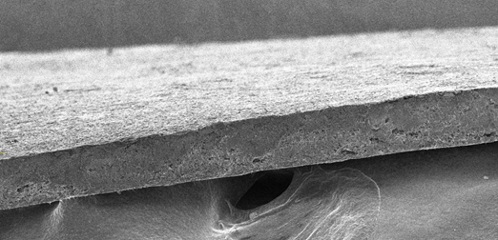
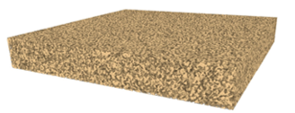
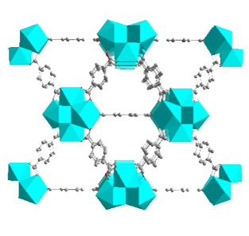
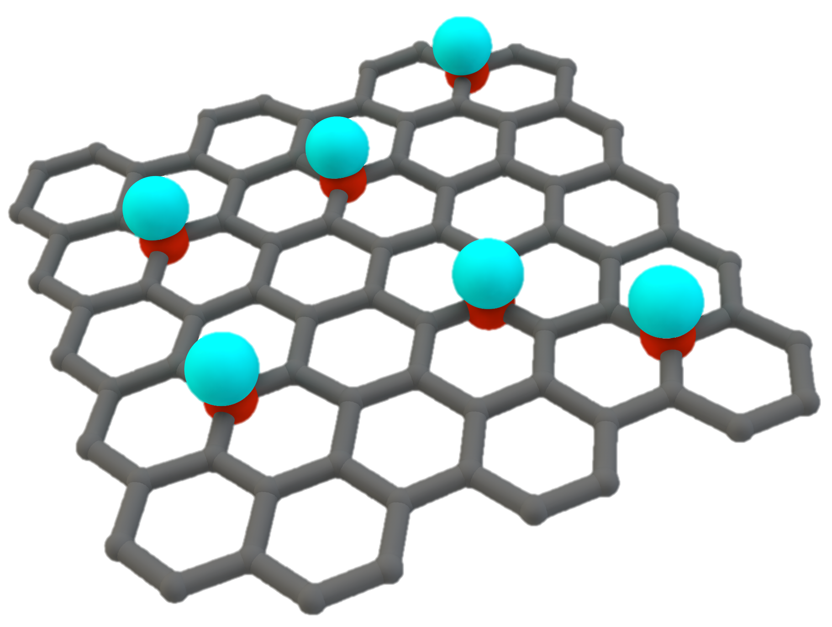
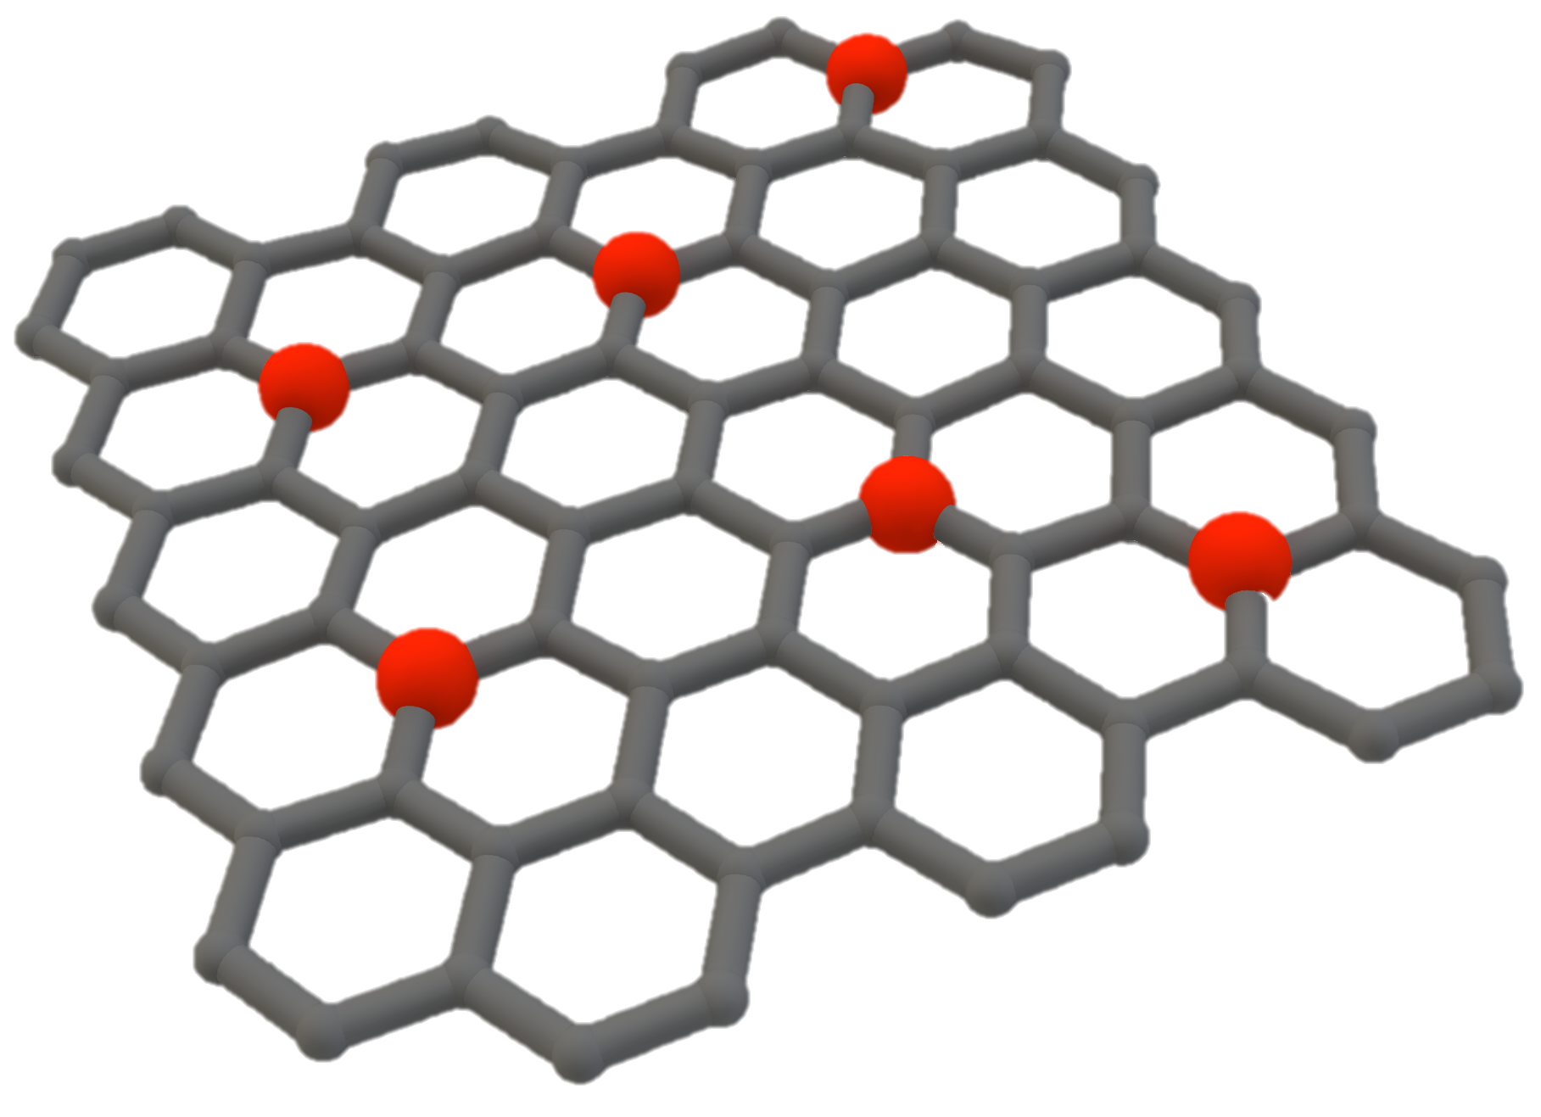
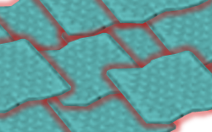
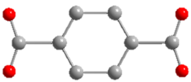
Hierarchical Assembly of Structurally Oriented Metal-Organic Frameworks as Novel Ionic Conductors
Chen, Pascal, Meng
University of California San Diego
Liquefied gas electrolytes enable low temperature operation due to their low freezing point. However, their high vapor pressure poses a safety concern. Can confinement of these gas electrolytes in a nanoscale material enhance electrochemical performance while minimizing the hazards?
Constructing hierarchical assemblies of microporous metal-organic framework (MOF)-polymer membranes following a “brick and mortar” approach.
Performing computational modeling of microcapillary condensation of gas electrolytes in the strong confinement regime of sub-nanometer pores.
Materials show uptake of hydrofluorocarbon gas molecules at pressures substantially lower than the bulk counterpart.
Unique ionic properties of the material enable significantly higher energy density at -40 °C compared with conventional electrolytes.
2 μm
50 μm
~75 μm
100 μm
100 μm
G. Cai et al, Sub-Nanometer Confinement Enables Facile Condensation of Gas Electrolyte for Low-Temperature Batteries, Nature Commun., 2021, in press.
Brick: GO@UiO-66
Mortar: PVDF
Coordination
In-situ growth
Solution-cast
Zr⁴⁺
GO
GO/Zr⁴⁺
GO@UiO-66
MPM
Notes:
SEED: This Seed asks the question: can liquefied gas electrolytes confined in a nanoscale material enhance electrochemical performance while minimizing the hazards of operating under extreme pressures or temperatures?
The hierarchical assembly of oriented metal organic frameworks (MOFs) can serve as a superior ionic conductor. The facile capillary condensation of gas electrolyte by strong confinement in sub-nanometer pores of MOF. By designing MOF-polymer membranes (MPMs) that present dense and continuous micropore (~0.8 nm) networks, we show significant uptake of hydrofluorocarbon molecules in MOF pores at pressure lower than the bulk counterpart. This unique property enables lithium/fluorinated graphite batteries with MPM-based electrolytes to deliver a significantly higher capacity than those with commercial separator membranes (~ 500 mAh g⁻¹ vs. < 0.03 mAh g⁻¹) at -40 °C under reduced pressure of the electrolyte.
Confining molecules in the nanoscale environment can lead to dramatic changes of their physical and chemical properties, which opens possibilities for new applications. Recently there is a growing interest in liquefied gas electrolytes for electrochemical devices operating at low temperatures such as outer space and deep sea explorations. However, the high vapor pressure of gas electrolytes still poses potential safety concerns for practical usages. Chen, Pascal and Meng developed a facile capillary condensation of gas electrolyte by strong confinement in sub-nanometer pores of metal-organic framework (MOF). The hierarchical assembly of MOF-polymer membranes show significant uptake of hydrofluorocarbon gas molecules at pressure lower than the bulk counterpart. The unique ionic property of such assembly enables batteries to deliver a significantly higher energy than those conventional batteries at -40 °C under reduced pressure of the gas electrolyte.

