Slide 1
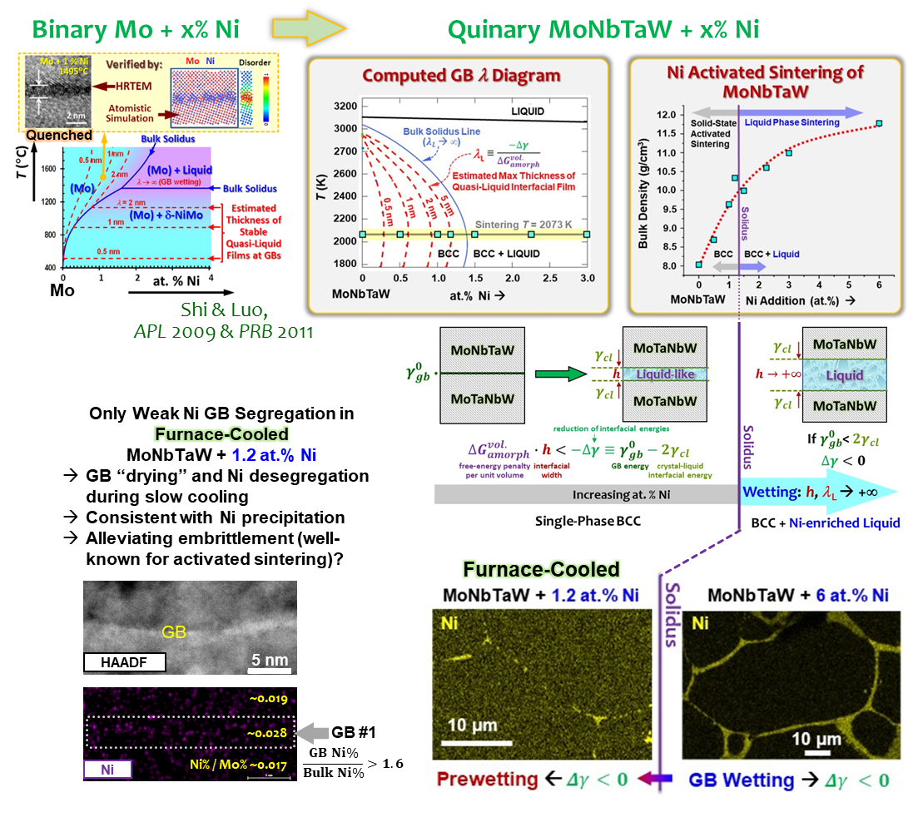
2024 IRG-1 Intellectual Merit
UCI MRSEC
DMR-2011967
Discovery of Ni Activated Sintering of MoNbTaW
Guided by a Computed Grain Boundary “Phase” Diagram
S. Shivakumar, K. Song, J. Luo (University of California, San Diego)
C. Wang, T. Lei, H.L. Xin, T.J. Rupert (University of California, Irvine)
In IRG-1, Luo, Xin, Rupert, and their students have discovered Ni activated sintering of MoNbTaW guided by a computed grain boundary “phase” (complexion) diagram.
This collaborative study made the first observation of solid-state activated sintering in a high-entropy alloy.
Grain boundary (GB) wetting was observed above the solidus line, implying subsolidus GB prewetting to promote sintering.
A GB λ diagram was computed to forecast high-temperature GB disordering and explain activated sintering.
Scanning transmission electron microscopy revealed only weak Ni segregation in furnace-cooled specimens, suggesting GB drying during cooling that may alleviate GB embrittlement.
S. Shivakumar, K. Song, C. Wang, T. Lei, H.L. Xin, T.J. Rupert, J. Luo
"Discovery of Ni Activated Sintering of MoNbTaW Predicted by a Computed Grain Boundary Diagram"
Scripta Materialia, 239, 115777 (2024)
https://doi.org/10.1016/j.scriptamat.2023.115777
Notes:
What Has Been Achieved:
This study discovers that Ni addition can enhance sintering of MoNbTaW both above and below the bulk solidus composition.
Experiments reveal complete grain boundary wetting above the bulk solidus composition, which logically infers the stabilization of a liquid-like interfacial phase in a prewetting region below the bulk solidus composition.
Furthermore, bulk CALPHAD methods have been extended to model GBs in Ni-doped MoNbTaW to compute a GB “phase” diagram to forecast high-temperature GB disordering in the prewetting region and rationalize the observed Ni-activated sintering of MoNbTaW.
Importance of the Achievement:
This study demonstrated the first example of activated sintering of a high-entropy alloy.
This study revealed a segregation-induced grain boundary prewetting (disordering) transition.
A grain boundary “phase” diagram has been computed for Ni-doped MoNbTaW to to forecast high-temperature grain boundary disordering and related activated sintering behaviors.
How is the achievement related to the IRG, and how does it help it achieve its goals?
This work resulted from collaboration of three PIs in IGR-1 and support all three IRG-1 central hypotheses:
Hypothesis #1: The increased compositional complexity of CCMs will lead to more structurally and chemically diverse interfaces, with increased structural disorder and boundary width due to local frustration and two-dimensional confinement. In this case, a grain boundary prewetting transition was revealed in Ni-doped MoNbTaW.
Hypothesis #2: Interfacial transitions in CCMs can be promoted by stimuli such as temperature, minority element doping, pressure, mechanical deformation, and their combination. In this case, segregation, along with temperature, induce grain boundary disordering transitions.
Hypothesis #3: Emergent macroscopic behavior can be predicted based on the local ordering of interfaces in CCMs. In this case, a computed grain boundary phase diagram predicts activated sintering.
Where the findings are published:
S. Shivakumar, K. Song, C. Wang, T. Lei, H.L. Xin, T.J. Rupert, J. Luo, "Discovery of Ni Activated Sintering of MoNbTaW Predicted by a Computed Grain Boundary Diagram," Scripta Materialia, 239, 115777 (2024). https://doi.org/10.1016/j.scriptamat.2023.115777

