Slide 1
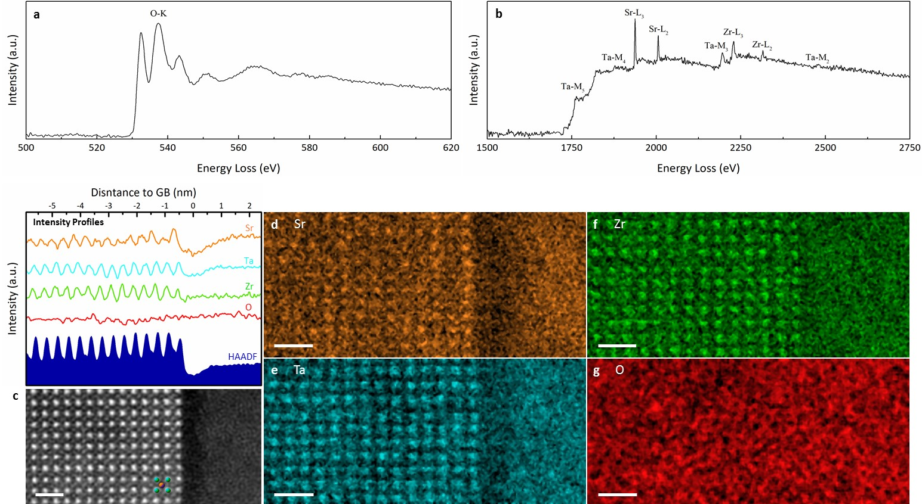
Atomic-scale origin of the low grain-boundary resistance in perovskite solid electrolyte Li_{0.375}Sr_{0.4375}Ta_{0.75}Zr_{0.25}O₃
2022 IRG-1 Intellectual Merit
DMR-2011967, MRSEC
T. Lee, C.A. Gadre, H. Huyan, C. Du, J. Li, T. Aoki, R. Wu, X. Pan (University of California, Irvine)
J. Qi, S. Ko, Y. Zuo, J. Luo, S. P. Ong (University of California, San Diego)
The main goal of this research is to reveal the atomic-scale origin of the low grain-boundary (GB) resistance in Li_{0.375}Sr_{0.4375}Ta_{0.75}Zr_{0.25}O₃ (LSTZ0.75) perovskite solid electrolyte and to provide insights on overcoming the ubiquitous bottleneck of high GB resistance in other oxide solid electrolytes.
Scientific highlight
· Aberration-corrected scanning transmission electron microscopy and spectroscopy, along with an active learning moment tensor potential, were used to reveal the atomic scale structure and composition of LSTZ0.75 GBs.
· Li depletion, which is a major cause for the low GB ionic conductivity of Li_{3x}La_{2/3-x}TiO₃ (LLTO), was found to be absent for the GBs of LSTZ0.75.
· A unique defective cubic perovskite interfacial structure that contained abundant vacancies was discovered at the GBs of LSTZ0.75. We attributed the low GB resistance of LSTZ0.75 to this microstructure.
· Based on our results, we conclude vacancy and defect engineering can effectively improve GB ionic conductivity of solid Li-ion conductors, given that the material’s original structural framework should be maintained.
Scientific impact
This study provides new insights into the atomic-scale mechanisms of low GB resistance and sheds light on possible paths for designing oxide solid electrolytes with high total ionic conductivity.
Core-loss EELS data of (010) faceted GB showing the unique defective cubic perovskite structure that contained cation vacancies.
Lee T, Qi J, Gadre CA, Huyan H, Ko ST, Zuo Y, Du C, Li J, Aoki T, Wu R, Luo J, Ong SP, Pan X, “Atomic-scale origin of the low grain-boundary resistance in perovskite solid electrolyte Li_{0.375}Sr_{0.4375}Ta_{0.75}Zr_{0.25}O₃”, In Preparation (2022)
Notes:
• Using an efficient active learning strategy, a moment tensor potential (MTP) for LSTZ0.75 was developed to accurately model both bulk and GB structures. Hybrid Monte Carlo/molecular dynamics (MC/MD) simulations corroborate the existence of Sr vacancies in both low- and high-sigma GBs, leading to comparable Li⁺ diffusivity at the GB and bulk regions. Additionally, these simulations indicate that disruption of A-site ordering in the grain bulk of LSTZ0.75 will result in higher bulk ionic conductivity.
• Vibrational electron energy loss spectroscopy (EELS) is applied for the first time to characterize the otherwise unmeasurable Li distribution in GBs of LSTZ0.75. Li depletion was found to be absent for the GBs of LSTZ0.75.
• In a broader perspective, the vibrational EELS approach presented here should be applicable to perovskite oxide solid electrolytes in general as well as any LIB material in which distinct Li-K edges cannot be convincingly identified via conventional low energy core-loss EELS. Similarly, the new active learning workflow we applied here should be generalizable to other complex structures beyond the scale of AIMD simulations. Detailed figure caption:
Integrated EEL spectra of a, O-K and b, Sr-L_{2,3}, Zr-L_{2,3}, Ta-M_{2,3}, and Ta-M_{4,5} edges for 010 faceted grain boundary shown in c. c, Atomic-resolution HAADF-STEM image of a 010 faceted grain boundary (with respect to the right-side grain). Atoms of a single unit cell (A-site centered view) are labeled. Elemental maps of d, Sr, e, Ta, f, Zr, and g, O. All scale bars are 1 nm. Intensity profiles of c – g are shown above c.

