Slide 1
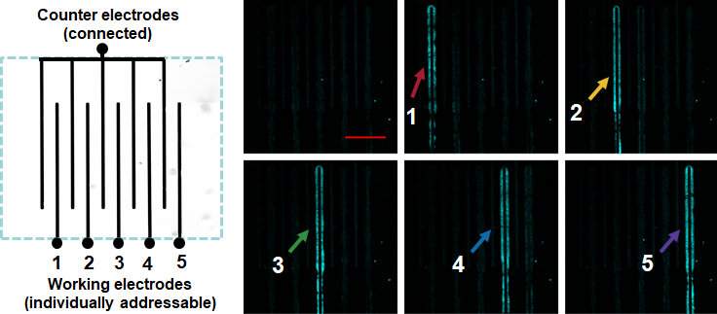
Electrically-Fueled Active Materials
2022 IRG-2 Intellectual Merit
DMR-2011967, MRSEC
S. Selmani, E. Schwartz, J. T. Mulvey, A. Grosvirt-Dramen, W. Gibson, A. I. Hochbaum, J. P. Patterson, R. Ragan, Z. Guan (University of California, Irvine)
Dissipative Self-Assembly
Fuel-driven self-assembly is ubiquitous in natural systems, leading to complex phenomena including cell motility, cell division, camouflage, and self-healing. Creating synthetic equivalents of these biological assemblies is challenging but offers the reward of active, dynamic materials.
Electrically-Fueled Assembly
Current synthetic dissipative self-assembly systems are fueled either by chemicals or light. Here, the UCI MRSEC team have developed the first electrically-fueled dissipative system that offers rapid kinetics, directionality, and unprecedented spatiotemporal control, closely mimicking systems found in nature. The electrochemically-fueled active, dynamic, and directional assembly is shown in Figure 1. Excitingly, the system demonstrates an unprecedented level of spatiotemporal control of self-assembly (Figure 2).
The team is now working on expanding this chemistry to a completely waste-free dissipative system. The transient behavior of dissipative self-assembly using dual electrocatalysts without generating any waste has been preliminarily demonstrated (Figure 3).
Figure 1. Fluorescence snapshots showing directional fiber growth when current was applied (green square), and dissolution when current was turned off (red square), scale bar = 50 µm.
0′
10′′
20′
20′10′′
40′
40′10′′
60′
Figure 3. Fluorescence snapshots showing fiber growth under voltage (green square) and dissolution when voltage is turned off (red square), scale bar = 100 µm.
Figure 2. Controlled growth and disassembly at individually addressable electrodes demonstrating unprecedented spatiotemporal control over dissipative self-assembly.
Selmani S, Schwartz E, Mulvey J, Wei H, Grosvirt-Dramen A, Gibson W, Hochbaum AI, Ragan R, Patterson J, Guan Z,* “Electrically fueled active supramolecular materials” Journal of American Chemical Society, 144, 7844-7851 (2022). https://doi.org/10.1021/jacs.2c01884

