Slide 1
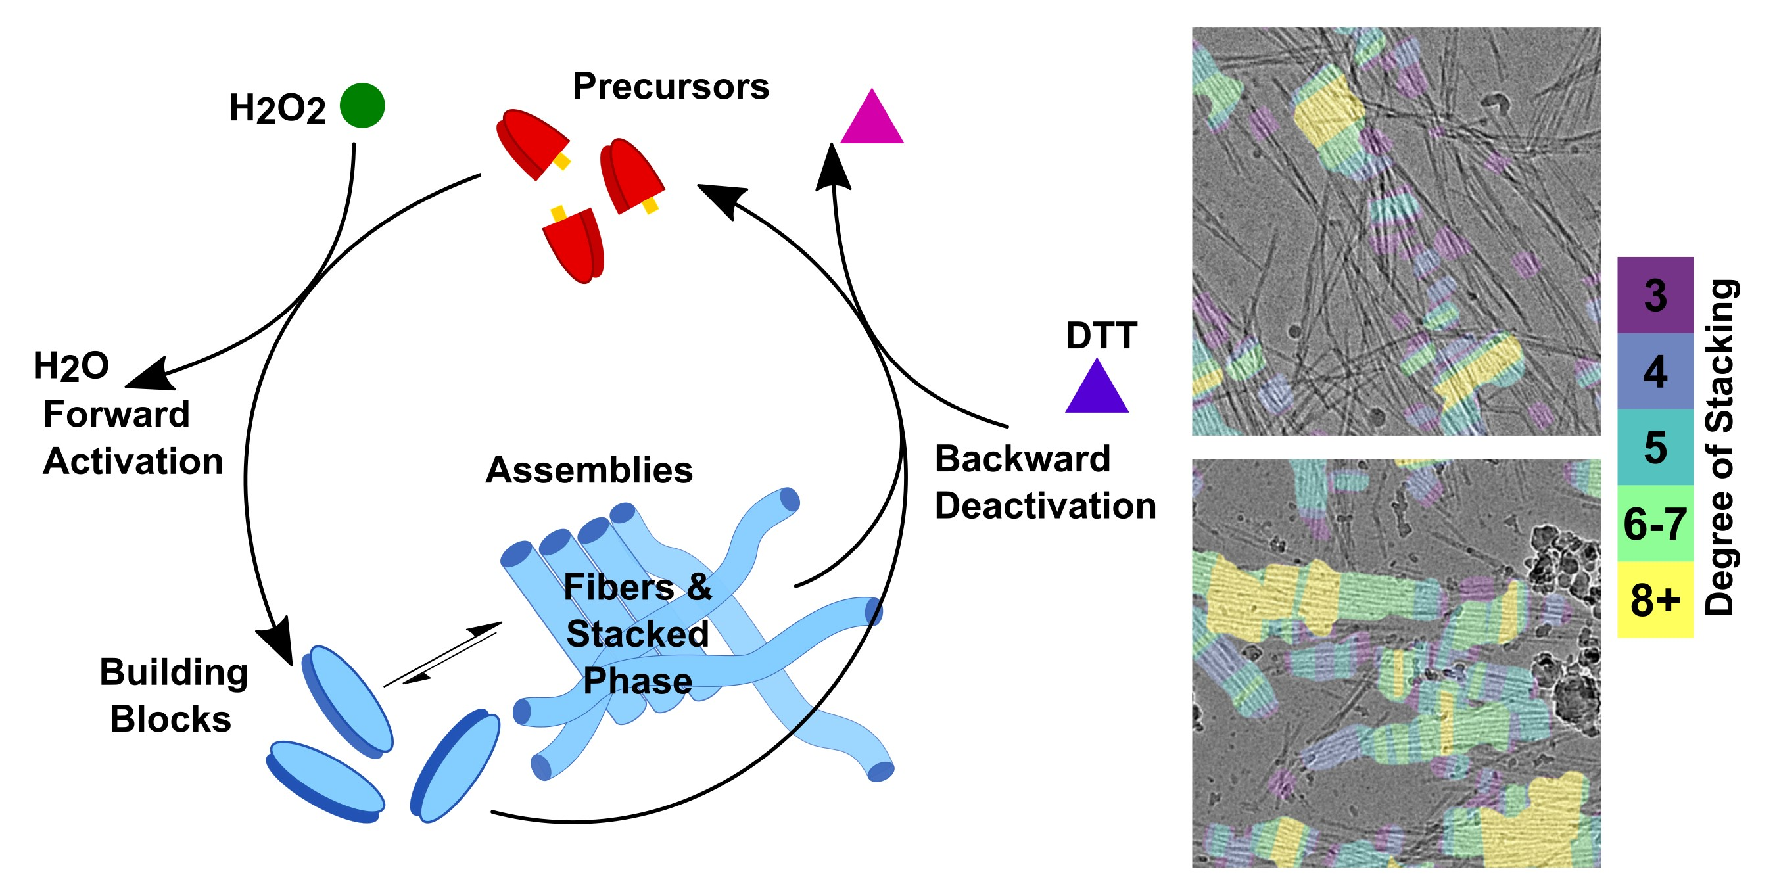
2024 IRG-2 Intellectual Merit
UCI MRSEC
DMR-2011967
CryoEM finds complexity in structural evolution of active materials
P. Hurst, S. Selmani, Z. Guan, J. Patterson (University of California, Irvine)
Synthetic active materials are designed to mimic complex biological materials such as microtubules.
Here, we studied a chemically driven active material using cryo electron microscopy which allowed us to see the structures these materials form at very high resolution.
We found that active materials can form specific types of structures, in this case ordered arrays of nanorods, for long periods of time (hours). In contrast, these structures would typically only form for a few seconds in conventional materials.
This is important because novel structures, especially ordered arrays, often display novel properties. We believe this new structural insight will lead to new applications for active materials.
This study advances the MRSEC IRG2 goal of engineering and controlling a active materials with unique structural properties that can respond to external stimuli.
A diagram showing a reaction cycle for a chemically driven active material. Hydrogen peroxide is used as a fuel to convert an inactive building block (red) to an active building block (blue) which assembles into a stacked nanorod phase. Simultaneously dithiothreitol (DTT) converts the active building blocks and the fibers back to the inactive building blocks. CryoEM images showing the stacked nanorods, annotated to show the degree of stacking.
Hurst, P. J.; Mulvey, J. T.; Bone, R. A.; Selmani, S.; Hudson, R. F.; Guan, Z.; Green, J. R.; Patterson, J. P.,* CryoEM reveals the complex self-assembly of a chemically driven disulfide hydrogel. Chemical Science 2024. doi.org/10.1039/D3SC05790A
Notes:
What Has Been Achieved: We have performed the first in-depth time-resolved cryo-electron microscopy study on molecular active materials formed under dissipative self-assembly conditions and compared the results to the same molecular formed under thermodynamic control. We found that the dissipative self-assembly conditions can stabilize the formation on transient, thermodynamically unstable phases and that these phases can be highly ordered.
Importance of the Achievement: From a design point of view, these findings are important as we can now tune the reaction kinetics to select for and enhance the yield of this unstable phase. We anticipate that these findings will also be useful for understanding how higher-ordered systems are maintained using synchronous chemistry and will aid in establishing tunable structure–property relationships and subsequent applications.
How is the achievement related to the IRG, and how does it help it achieve its goals? This strikes to the heart of IRG2 goals of understanding and controlling active materials through dissipative self-assembly mechanisms.
Where the findings are published: Chemical Science 2024. doi.org/10.1039/D3SC05790A

