Slide 1
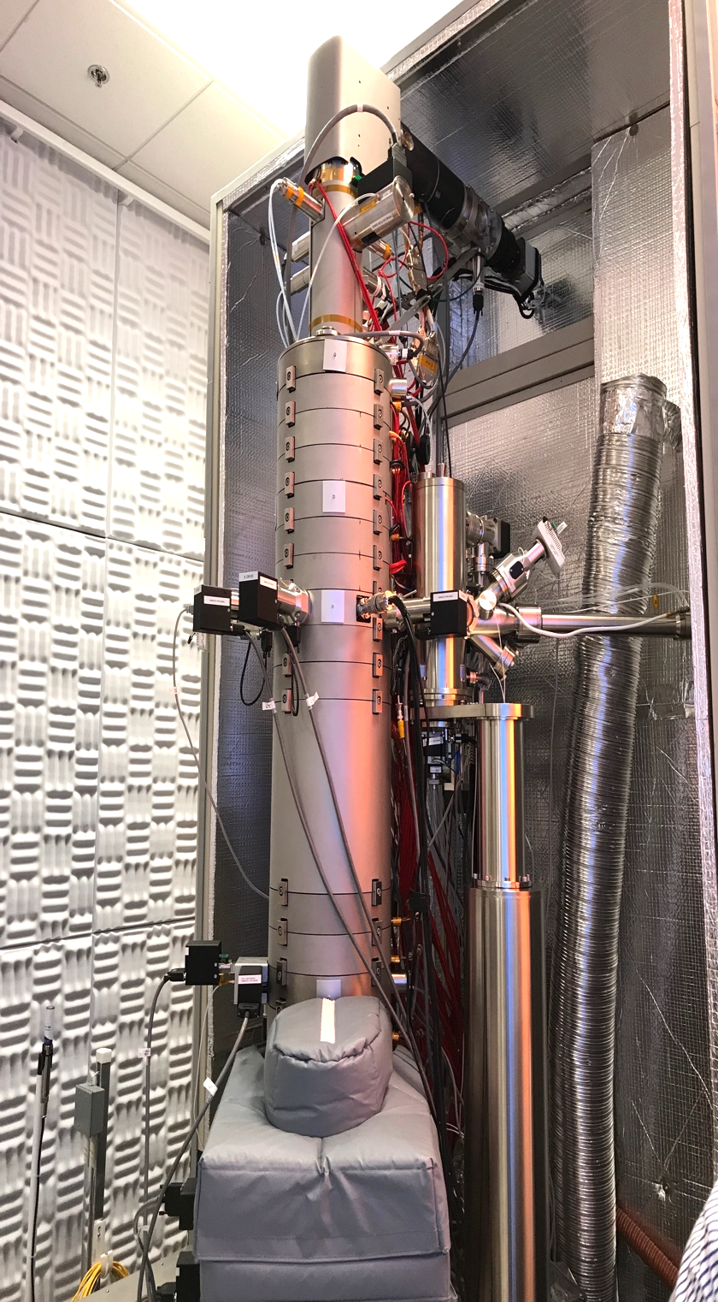
Single-Defect Phonons Imaged by Electron Microscopy
2021 Shared Facilities
DMR-2011967, MRSEC
Xiaoqing Pan, Ruqian Wu, University of California, Irvine
The new Nion HERMES 200 is an aberration corrected, monochromated scanning transmission electron microscope (STEM) equipped with angle-resolved electron energy-loss spectroscopy (EELS), which is the first at a University Shared Facility.
Based on the new capabilities of this instrument, the UCI MRSEC team (Pan and Wu) demonstrated, for the first time, exotic atomic vibrations localized at a single stacking fault in cubic SiC, showing by an energy shift of 3.8 meV and an obvious intensity modulation of the acoustic phonon mode.
Yan, X., Liu, C., Gadre, C.A. et al. Single-defect phonons imaged by electron microscopy. Nature 589, 65–69 (2021). https://doi.org/10.1038/s41586-020-03049-y
Left panel: Nion UltraSTEM. Right panel: Sketch of a stacking fault in cubic SiC (top) and 3D plot of phonon spectra mapped by EELS (bottom).

