Slide 1
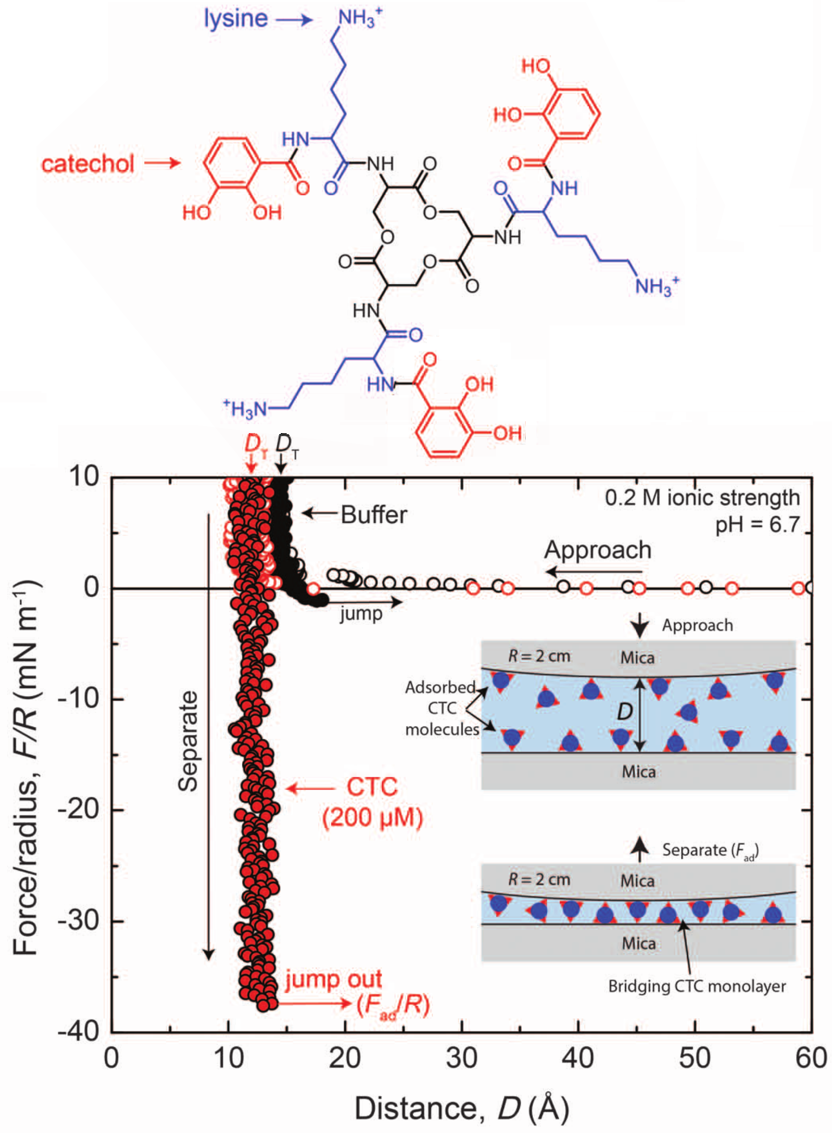
IRG-1: Bio-Inspired Wet Adhesion
Synergistic Chemical Action Leads to Enhanced Adhesion
Craig J. Hawker, University of California
Santa Barbara, DMR 1121053
Siderophores are compounds in microorganisms that bind and store iron. Parallels between the chemistry of compounds secreted by mussels to aid adhesion to rocks, and the chemistry of some siderophores inspired UCSB researchers Butler, Israelachvili, and Waite and their coworkers to study their adhesive properties.
Siderophores appear to synergistically employ catchecol and lysine functionalities to adhere to hard oxide (minerals such as mica) surfaces, as verified using the surface forces apparatus (force-distance traces shown at right). The key molecule cyclic trichrysobactin (a siderophore, abbreviated CTC) is displayed alongside, with the catechol and lysine moieties indicated.
Published in Science 349 (2015) 628–632.

