Slide 1
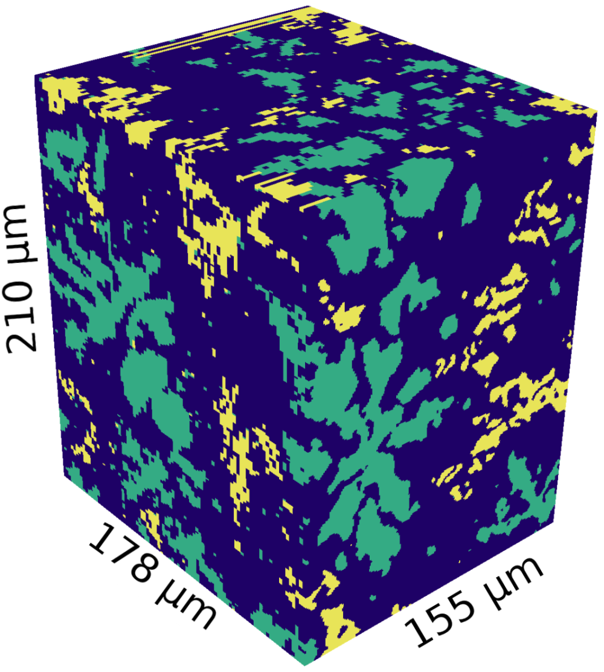
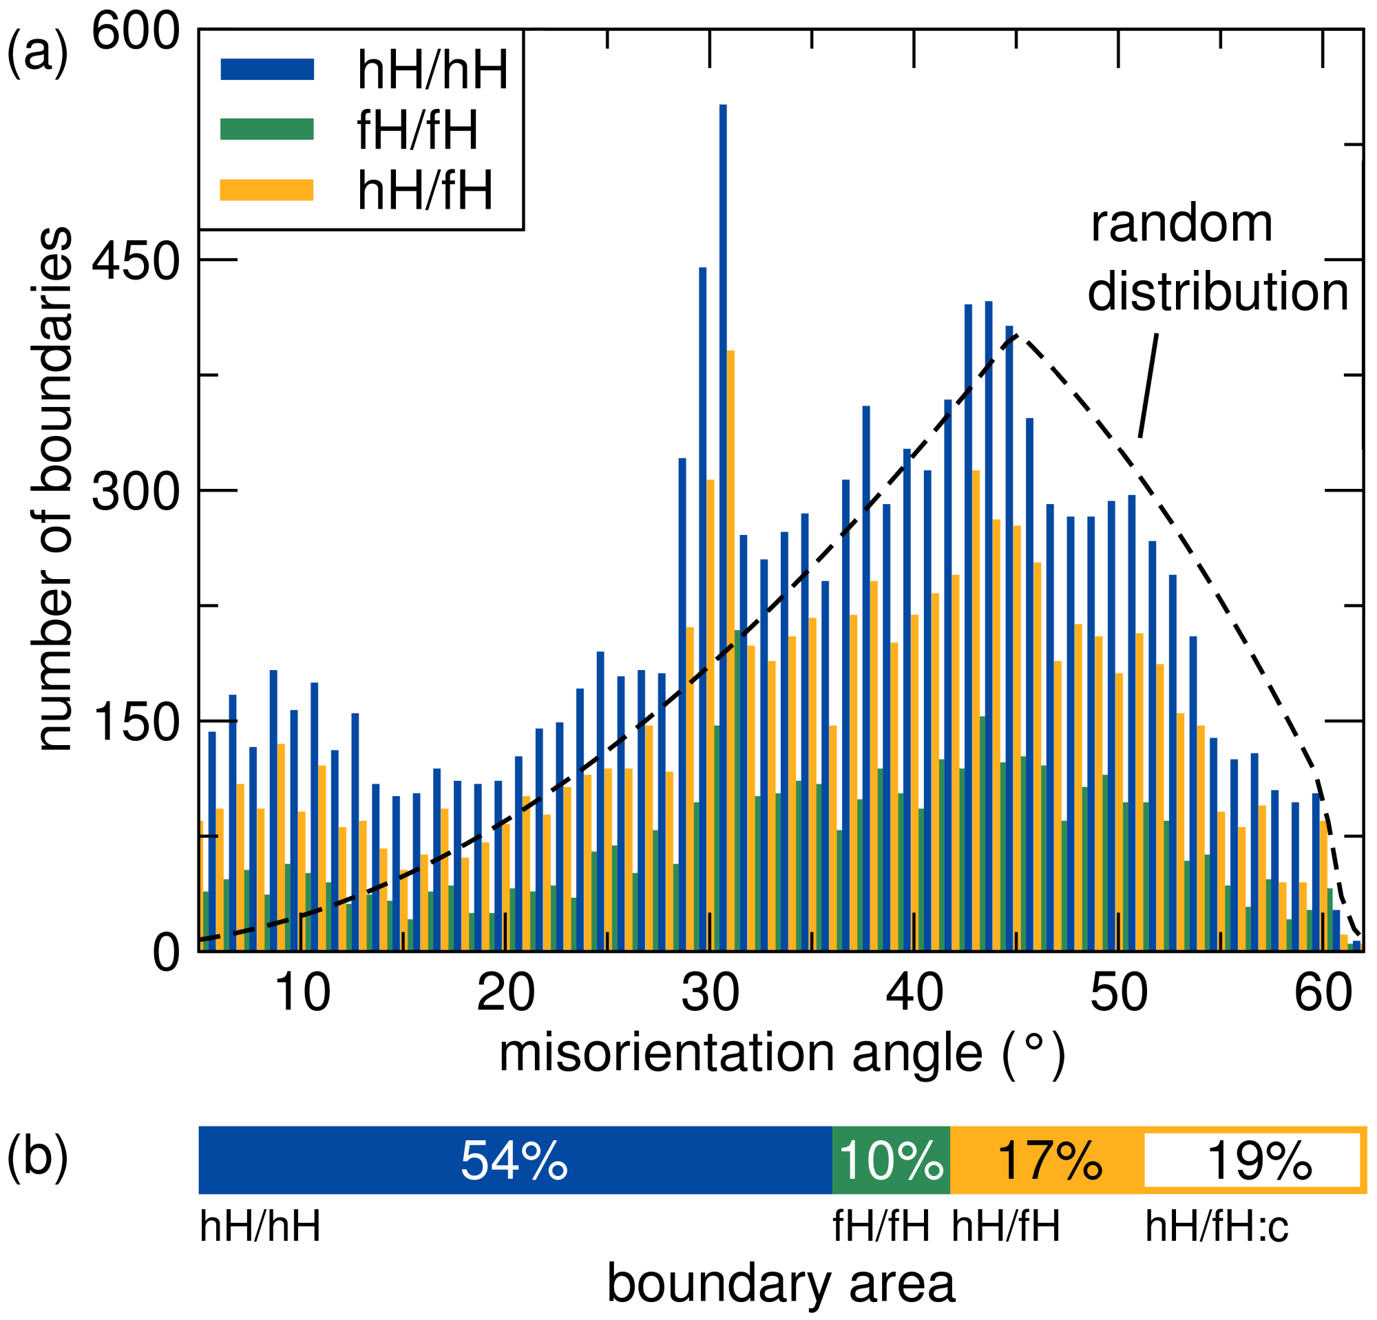
IRG-3: Robust Biphasic Materials
3D Multimodal Imaging of Biphasic Thermoelectrics
Craig J. Hawker, University of California
Santa Barbara, DMR 1121053
The use of a prototype “TriBeam” microscope, a scanning electron microscope equipped with a femtosecond laser for rapid serial sectioning, allows 3D views of materials to be obtained. Incorporating both chemical data and crystallographic data has allowed the nature, structure, and crystal orientation of the components to be determined within a 155 μm × 178 μm × 210 μm volume of a biphasic Heusler thermoelectric material.
Right top: Visualization of the TiNi_{1.20}Sn dataset, 155 μm × 178 μm × 210 μm in size. Surfaces of the volume colored by phase, where blue is TiNiSn, green is TiNi₂Sn, and yellow is a Ti–Sn binary. Bottom: Misorientation distribution function for grain boundaries at each of three interfaces in the volume: TiNiSn/TiNiSn (hH/hH), TiNiSn/TiNi₂Sn (hH/fH), and TiNi₂Sn/TiNi₂Sn (fH/fH).
Published in APL Mater. 3 (2015) 096107.

