Slide 1
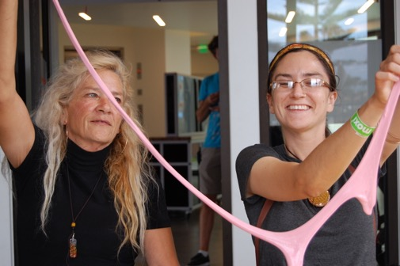
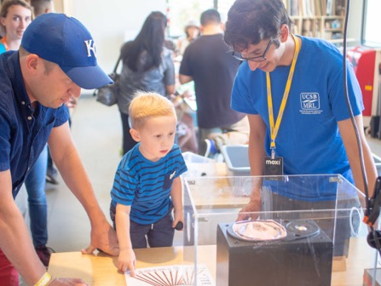
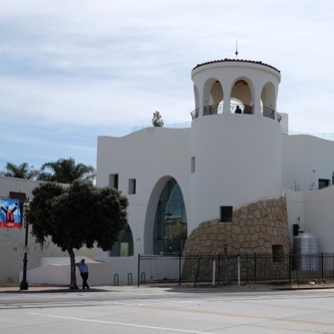
The UCSB MRSEC Partners with the Wolf Museum of Exploration and Innovation (MOXI)
NSF-DMR-1720256
2019
University of California Santa Barbara
Visitors of all ages enjoy polymer activities led by UCSB MRSEC graduate students and faculty at the MOXI, Santa Barbara.
The UCSB MRSEC is excited to announce a new partnership with Santa Barbara’s Wolf Museum of Exploration and Innovation (MOXI). Open in 2017, the MOXI provides a space for hands-on exploration in science and creativity for children and families.
In August 2018 the UCSB MRSEC provided a week of polymer activities in MOXI’s Innovation Workshop that attracted approximately 700 visitors

