Slide 1
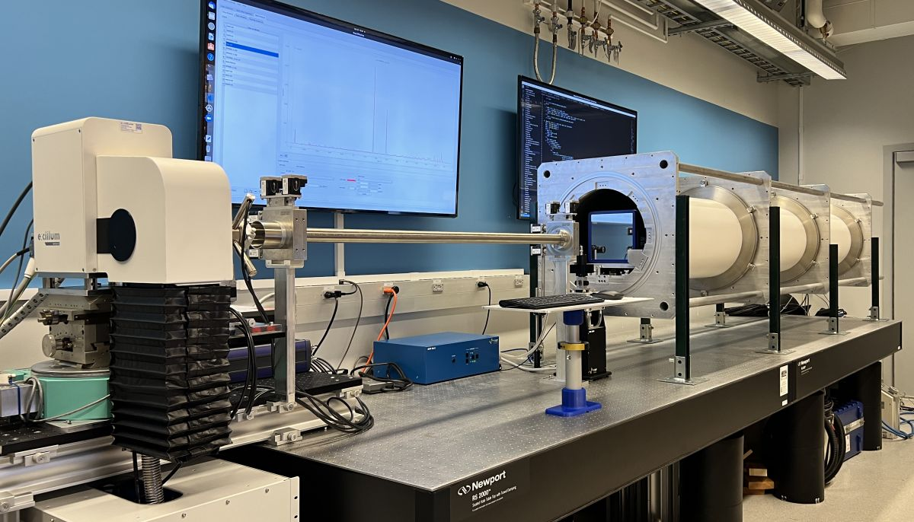
Facilities: Development of a high brilliance laboratory SAXS/WAXS beamline
NSF DMR 1720256
2022 Highlight
Intellectual merit: In collaboration with the newly established NSF BioPacific MIP, the MRL X-ray facility team spearheaded the development of an SAXS-WAXS (small and wide angle x-ray scattering) laboratory beamline with unparalleled beam brightness for high throughput characterization of biopolymers and nanostructures. The instrument, incorporating a liquid metal jet x-ray source (with the highest beam brightness in a lab environment) and a 4 megapixel photon counting area detector, provides a performance level comparable to a 2nd generation synchrotron . The beamline is optimized for high throughput capabilities by incorporating a high degree of automation, an intuitive user interface and smart analysis software for rapid measurement turn around as well as versatility to suit a wide range of applications.
Broader Impacts: The platform instrument is available via a user proposal program, with broader impact on a wide research community.
University of California Santa Barbara
D2+ MetalJet
Detector
Beam Pipe
Collimator
The BioPacific MIP SAXS/WAXS beamline. The six-meter long platform instrument is custom designed and constructed by a research and development team that has been supporting the MRL X-ray Diffraction facility. Many design elements were inspired by the original SAXS/WAXS instrument built by the same team in the MRL X-ray Facility.

