Slide 1
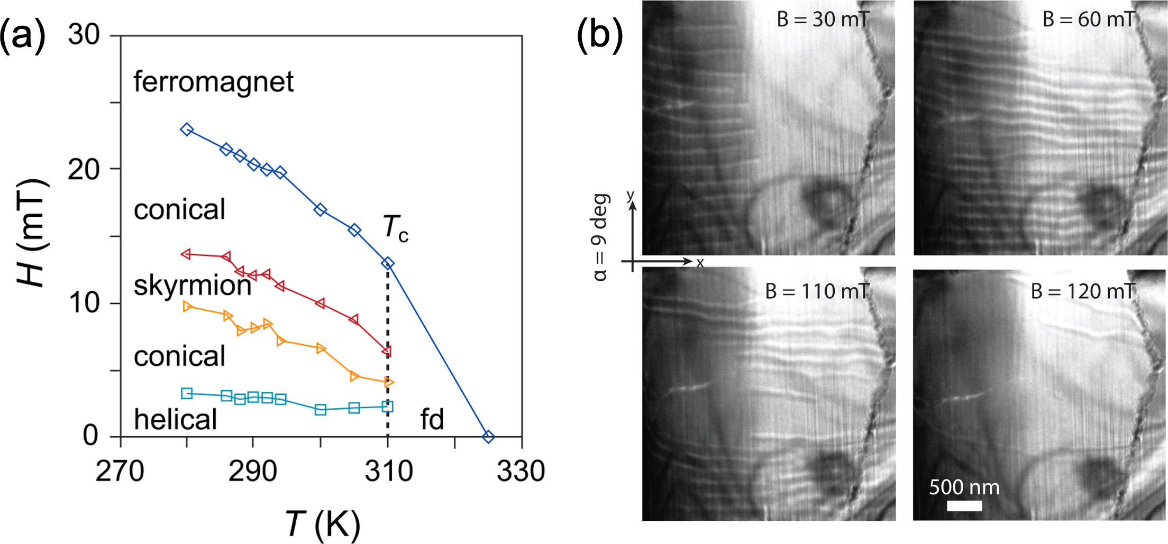

UC Santa Barbara MRSEC
DMR-1720256
IRG–1 Skyrmion Transitions in Co₈Zn₈Mn₄ at Room Temperature
D. S. Gianola, A. Bleszynski Jayich, T. M. Pollock, R. Seshadri, A. Van der Ven, S. D. Wilson
Intellectual merit: Magnetic skyrmions are topologically-protected spin textures that manifest in certain noncentrosymmetric ferromagnets under the right conditions of temperature and field. Here we present Lorentz transmission electron microscopy (LTEM) evidence in conjunction with numerical modeling showing a flop transition between in-plane and out-of-plane skyrmions in Co₈Zn₈Mn₄ at room temperature. This flop transition is controllable via the angle of the external field relative to the film normal and has a controllable thickness-dependence.
Broader Impacts: Skyrmionic systems have been proposed as novel means or very high-density magnetic data storage that can be topologically protected against accidental erasure. The work here advances methods of “writing” skyrmions at room temperature –– an important step towards this goal.
Figure: (a) Magnetic phase diagram for bulk Co₈Zn₈Mn₄ as a function of applied magnetic field H, and temperature T. (b) LTEM sequence of images of a wedge of Co₈Zn₈Mn₄ with the applied field held at a constant angle (α = 9◦) while increasing magnetic field strength B showing in-plane skyrmions extending into the film. As the field increases, the skyrmions contract in size and reach into the thinner regions.
S. A. Meynell, Y. M. Eggeler, J. D. Bocarsly, D. A. Kitchaev, B. E. Rhodes, T. M. Pollock, S. D. Wilson, A. Van der Ven, R. Seshadri, M. De Graef, A. Bleszynski Jayich, and D. S. Gianola, Inducing skyrmion flop transitions in Co₈Zn₈Mn₄ at room temperature, Phys. Rev. Mater. 7, 044401 (2023).

