Slide 1
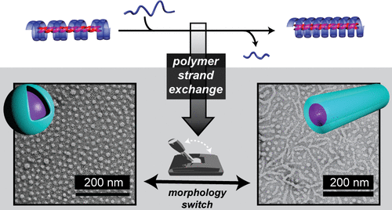
NSF-DMR-1720256
2019
IRG-3: DNA-inspired switchable synthetic morphologies
Intellectual merit: Novel PMMA strand-exchange, inspired by DNA nanotechnologies, enables dynamic behaviors in synthetic polymeric systems. Polymer assembly produces spherical or wormlike micelles, which can be reversibly switched between different morphologies.
Broader Impacts: This novel strategy offers new opportunities to program dynamic behaviors in synthetic polymeric systems, leading to scalable synthesis of “smart” nanosystems.
University of California Santa Barbara
Low-MW PMMA
Triple helix
High-MW PMMA
Triple helix
Ren, Knight, van Ravensteijn, Kohl, Bou Zerdan, Li, Lunn, Abdilla, Qiao, Hawker, DNA-inspired strand-exchange for switchable PMMA-based supramolecular morphologies, J. Am. Chem. Soc. 141 (2019) 2630–2635. DOI: 10.1021/jacs.8b12964

