Slide 1
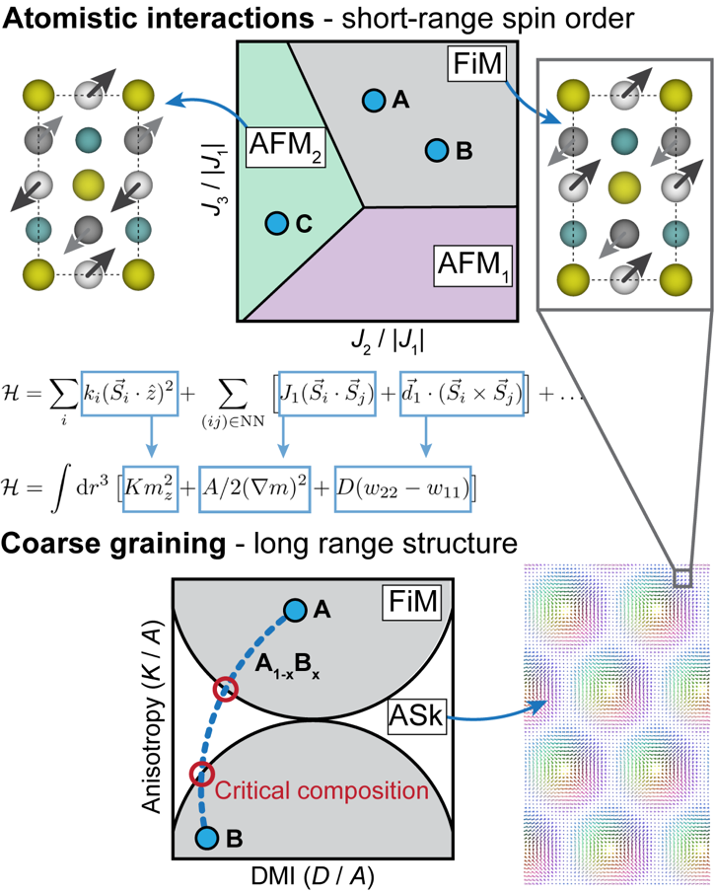
IRG1: Tuning magnetic antiskyrmion stability in tetragonal inverse Heusler alloys
NSF DMR 1720256
2022 Highlight
University of California Santa Barbara
Intellectual merit: A computational approach
was implemented to design Mn₂XY tetragonal inverse Heusler alloys that host magnetic antiskyrmions whose stability are sensitive to elastic strain. A universal magnetic Hamiltonian was first studied systematically to establish regions in magnetic interaction space close to magnetic transitions. First-principles calculations were then performed to determine the placement of many tetragonal inverse Heusler compounds relative to these magnetic phase boundaries, thereby revealing alloying strategies to achieve compounds that can access different magnetic phases through elastic strain.
Broader Impacts: The identification of materials supporting complex, tunable magnetic order at ambient temperatures is foundational to the development of new magnetic device architectures. A novel materials design approach was developed and implemented to identify magnetic alloys whose magnetic behavior can be tuned mechanically.
Top: Multiscale computational design approach to identify magnetic alloys with prescribed properties.
Kitchaev, Van der Ven, Tuning magnetic antiskyrmion stability in tetragonal inverse Heusler alloys, Physical Review Materials 5 (2022) 124408. DOI: 10.1103/PhysRevMaterials.5.124408

