Slide 1
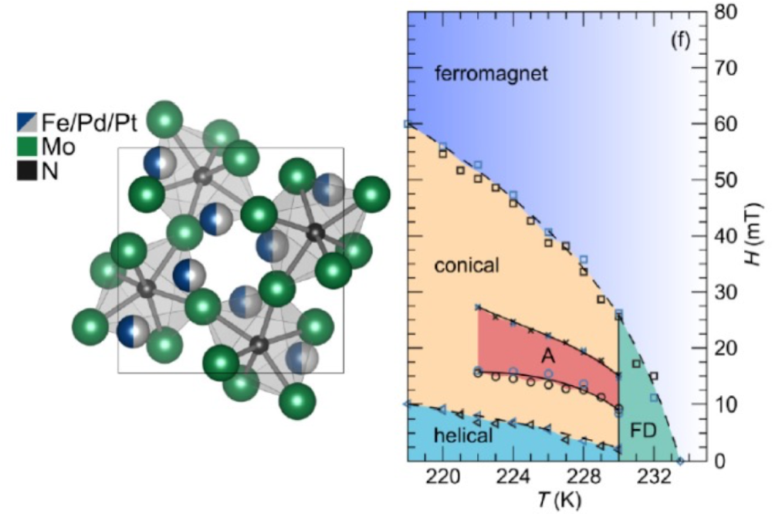
IRG-1: Controlling skyrmion size in the alloy FePd_{1−x}Pt_{x}Mo₃N
NSF DMR 1720256
2020 Highlight
University of California Santa Barbara
Intellectual merit: Controlling the topological defect states known as skyrmions in magnetic materials is an enduring challenge. After discovering a new magnetic host of skyrmion states, IRG researchers were able to show that chemically alloying the compound FePd_{1−x}Pt_{x}Mo₃N allows for the size of the skyrmion defects to be controlled while still preserving their stability.
Broader Impacts: Skyrmion states are broadly sought in new materials due to their potential uses in low power memory devices and other spin-based electronics. Tailoring the size of skyrmion states is also essential to functionalizing materials to suite these proposed applications. IRG researchers have demonstrated that this size control is possible in a new material where, ultimately, smaller skyrmion sizes are desired.
Left: Crystal structure of FePd_{1−x}Pt_{x}Mo₃N. Right: Magnetic phase diagram of FePtMo₃N showing the emergence of a skyrmion state in the “A” region. FD shows the fluctuation disordered regime.
Kautzsch, Bocarsly, Felser, Wilson, Seshadri, Controlling Dzyaloshinskii-Moriya interactions in the skyrmion host candidates FePd_{1−x}Pt_{x}Mo₃N, Phys. Rev. Mater. 4 (2020) 024412. DOI: 10.1103/PhysRevMaterials.4.024412

