Slide 1
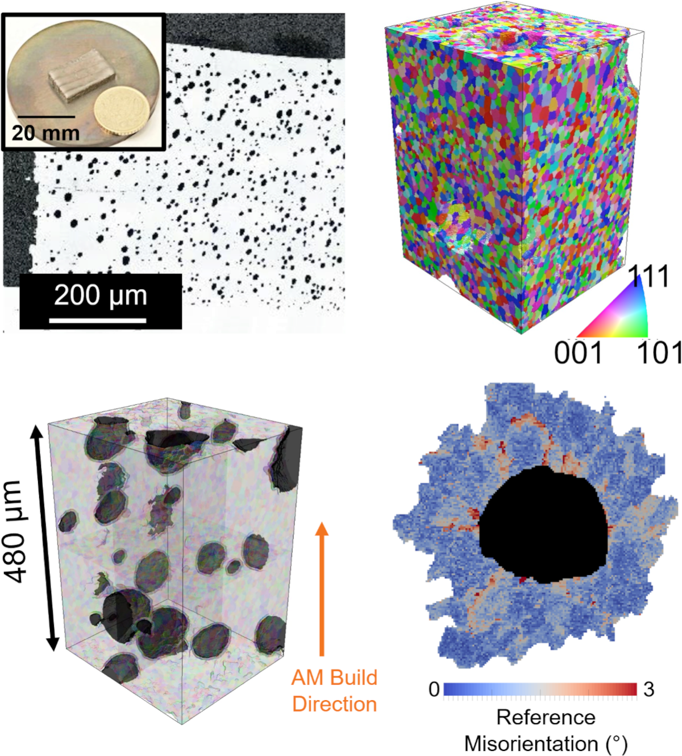
IRG1: Microstructural evolution in additively manufactured magnetic materials
NSF DMR 1720256
2022 Highlight
University of California Santa Barbara
Intellectual merit: Samples of Alnico magnets were printed by selective laser melting, and their microstructure was investigated in 3D at the mm³-scale using the femtosecond-laser enabled TriBeam microscope. A multiscale characterization effort revealed an equiaxed grain structure with printing-induced porosity, as well as the presence of magnetic spinodal ɑ₁//ɑ₂ phase, leading to moderate coercivities.
Broader Impacts: Additive manufacturing of functional materials is still nascent, yet promises the ability to build permanent magnets into complex geometries for use in actuators and electric motors for increasing performance and reducing weight. Since Alnico material is hard to mechanically work into final shapes, any near net shape manufacturing such as additive manufacturing would provide a major advantage over conventional fabrication routes.
Top: Additively manufactured Alnico magnets and 3D microstructure generated using TriBeam tomography.
Rottmann, Polonsky, Francis, Emigh, Krispin, Rieger, Echlin, Levi, Pollock, TriBeam tomography and microstructure evolution in additively manufactured Alnico magnets, Materials Today 49 (2021) 23-34.
DOI: 10.1016/j.mattod.2021.05.00323

