Slide 1
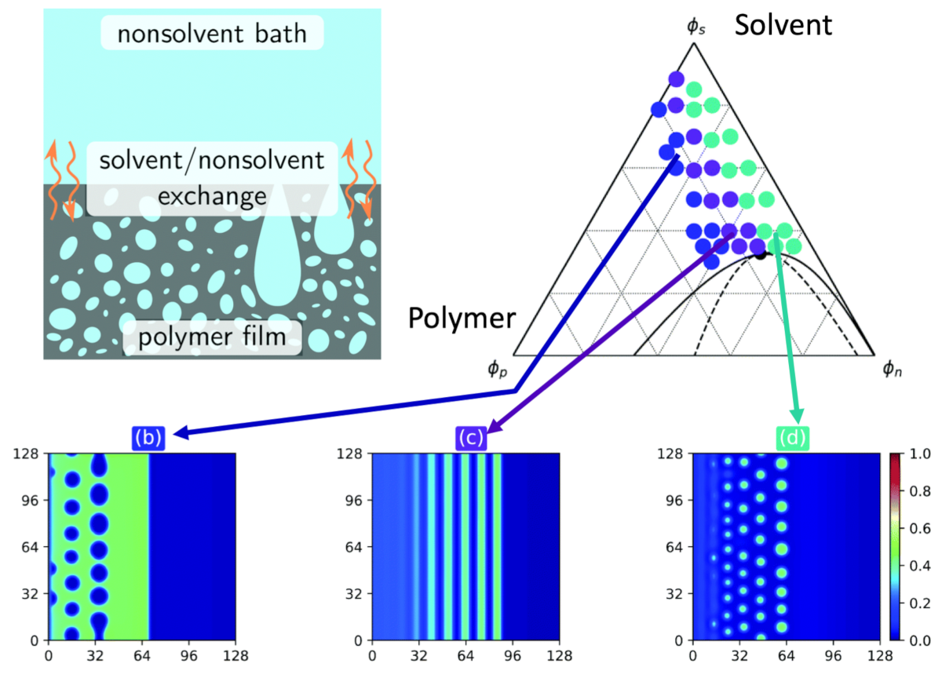
IRG-3: Microstructure modeling in nonsolvent induced phase separation (NIPS)
NSF DMR 1720256
2020 Highlight
University of California Santa Barbara
Intellectual Merit: NIPS is a non-equilibrium liquid-liquid phase separation phenomenon used to make polymer membranes through solvent-nonsolvent exchange. Newly developed phase-field simulations allow investigation of coupled mass transfer, flow and thermodynamic instability during processing and the corresponding microstructures that result from variations in film composition and thickness.
Broader Impacts: These simulation tools provide critical insight into the nonequilibrium processing of complex fluids to make architectured, resilient solids and soft materials.
Modeling liquid-liquid phase separation to control polymer architecture.
Tree, Dos Santos, Wilson, Scott, Garcia, Fredrickson, Mass-transfer driven spinodal decomposition in a ternary polymer solution, Soft Matter 15 (2019) 4614. DOI: 10.1039/c9sm00355j

