Slide 1
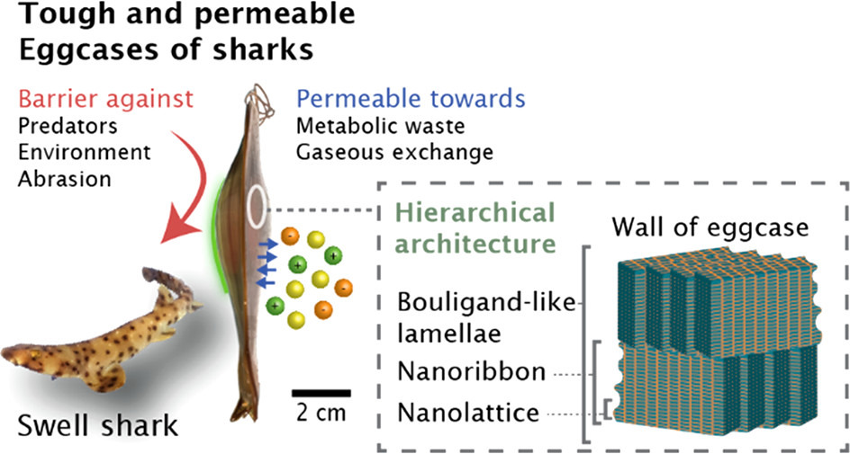
IRG3: Nanolatticed Architecture Mitigates Damage in Shark Egg Cases
NSF DMR 1720256
2022 Highlight
University of California Santa Barbara
Intellectual merit: Structure-mechanics analysis of shark egg cases has revealed that dynamic reorganization of the nanolatticed architecture provides strength and resilience without compromising permeability.
Broader Impacts: The nanostructured egg case of swell sharks is one of the toughest permeable membranes known. These fundamental insights provide design targets for multifunctional soft composites, and mechanical metamaterials.
Left: Schematic of swell shark and egg casing. Right: Inset shows hierarchical nanostructures that deform under stress.
R. Goh, S.P.O. Danielsen, E. Schaible, R.M. McMeeking, J.H. Waite, Nanolatticed architecture mitigates damage in shark egg cases, Nano Letters 21 (2021) 8080-8085. DOI: 10.1021/acs.nanolett.1c02439

