Slide 1
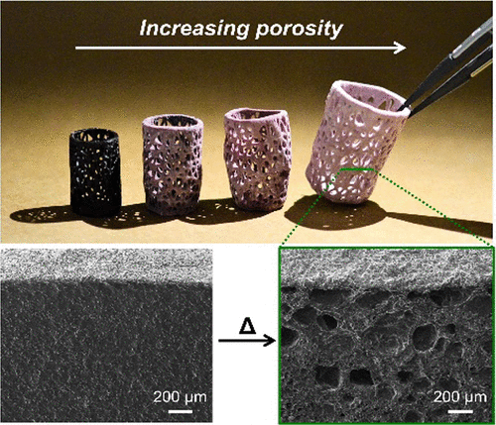
IRG3: Three-Dimensional Photochemical Printing of Thermally Activated Polymer Foams
NSF DMR 1720256
2022 Highlight
University of California Santa Barbara
Intellectual merit: This work demonstrates the facile, on-demand manufacturing of polymer foams with desirable properties such as mechanical strength, controlled porosity, and varied composition. Key to the success is the design of building blocks and monomer units based on a two-step process: initial 3D photopolymerization and subsequent thermal processing.
Broader Impacts: The materials and methods developed in this work are amenable to traditional 3D printing, and offer new opportunities to generate foams with tailored structures, geometries and mechanics.
Top: Examples of printed structures with complex geometries. Bottom: Internal structures before (left) and after (right) heating, showing the thermal activation of microporosity.
S.E. Seo, Y. Kwon, N.D. Dolinski, C.S. Sample, J.L. Self, C.M. Bates, M.T. Valentine, C.J. Hawker,
Three-dimensional photochemical printing of thermally activated polymer foams, ACS Applied Polymer Materials 3 (2021) 4984-4991. DOI: 10.1021/acsapm.1c00726

