Slide 1
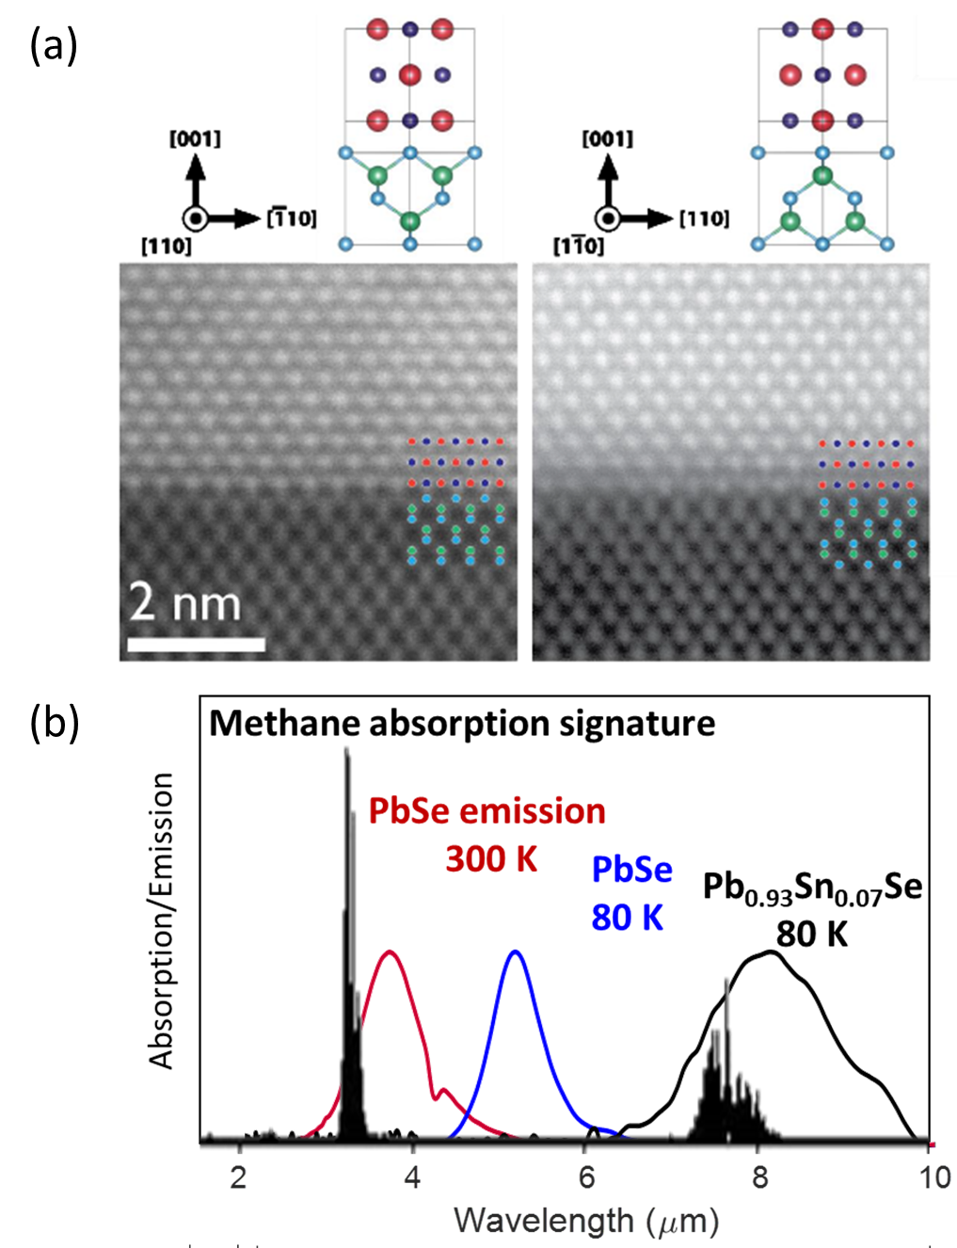
Seed: Interfacing with Topological Crystalline Insulators
NSF DMR 1720256
2020 Highlight
University of California at Santa Barbara
Intellectual merit: We demonstrate a route to high quality interfaces between IV-VI PbSnSe and conventional III-V semiconductors, offering means to host and manipulate electronic states that arise at this interface. We can now clarify the extent to which topological protection from backscattering persist in systems at relevant length scales for logic and interconnects using these novel materials
Broader Impacts: Heterostructures between IV-VI and III-V materials may enable mid-infrared on-chip environmental and biological sensing.
B. Haidet, E. Hughes, and K. Mukherjee, Nucleation control and interface structure of rocksalt PbSe on (001) zincblende III-V surfaces, Phys. Rev. Materials 4 (2020) 033402. DOI: 10.1103/PhysRevMaterials.4.033402
(a) High-resolution transmission electron micrograph showing the interface between PbSe and an InAs substrate. (b) Mid-infrared photoluminescence spectra from IV-VI/GaAs heterostructures overlapping with absorption of methane

