Slide 1
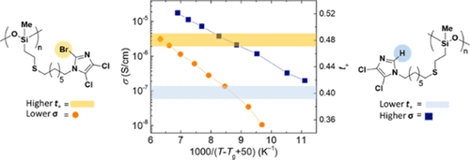
Electron-Deficient Imidazoles in Solid-State Polymer Electrolytes
NSF DMR 1720256
2022 Highlight
University of California Santa Barbara
Intellectual merit: Solid-state polymer electrolytes offer a safer alternative to traditional lithium-ion batteries based on organic electrolytes. However, current benchmark polymer electrolytes lack ion transport selectivity (t₊ = 0.2) which limits their commercial use. We demonstrate the enhancement of lithium-ion transport (t₊ = 0.48) of PMS-based polymers by taking advantage of the steric and electronic properties of imidazole ligands. This study highlights the importance of weak cation-polymer binding to obtain high Li⁺ transport numbers.
Broader Impacts: Understanding how ligand choice influences total ionic conductivity and lithium-ion transport will enable the development of next-generation solid-state polymer electrolytes with superior performance. Such materials can potentially be used in energy storage applications on a commercial scale.
Top: Enhancing lithium-ion transport in solid-state polymer electrolytes using electron-deficient imidazole ligands. Our study indicates that steric and electronic ligand properties are critical for enhancing lithium-ion diffusion and transport.
Andrei Nikolaev, Peter M. Richardson, Shuyi Xie, Luana Llanes, Seamus D. Jones, Hengbin Wang, Rachel A. Segalman, Raphaële J. Clément, and Javier Read de Alaniz. Role of Electron-Deficient Imidazoles in Ion Transport and Conductivity in Solid-State Polymer Electrolytes. Macromolecules, 2022, 55, 971-977.
DOI: 10.1021/acs.macromol.1c01979

