Slide 1
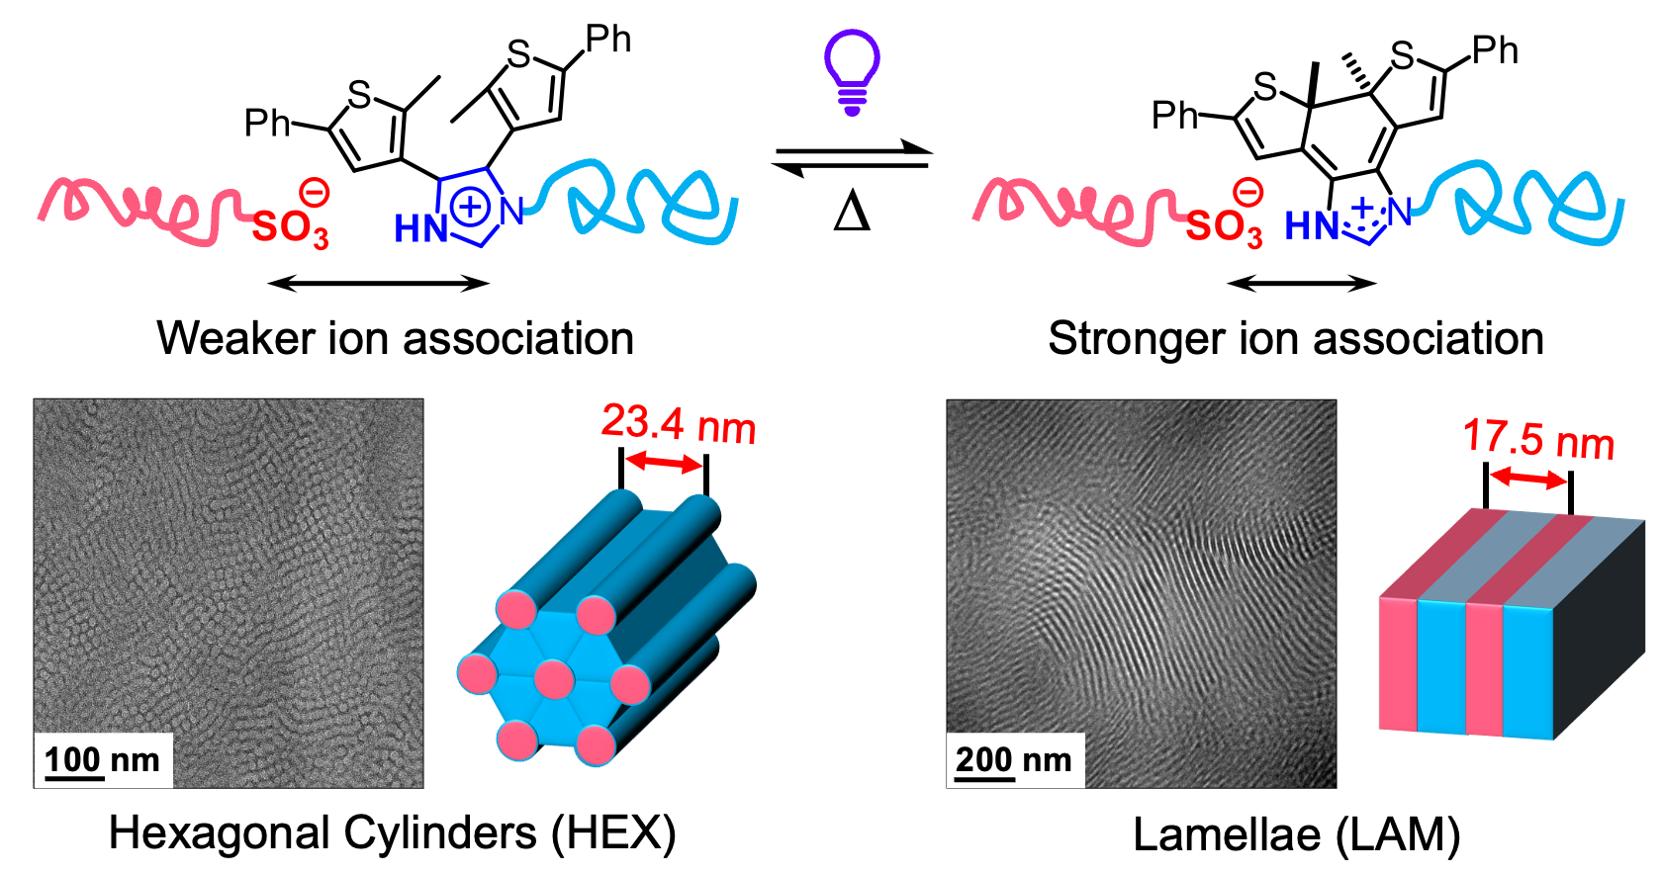
UC Santa Barbara MRSEC
DMR 2308708
Photoinduced Morphology Change in Ionically Compatibilized Copolymer
Javier Read de Alaniz and Rachel Segalman (UC Santa Barbara)
Previously, UC Santa Barbara MRSEC researchers demonstrated that chain-end functionalization of immiscible polystyrene/polydimethylsiloxane (PS/PDMS) blends with oppositely paired acid and base groups forms ionic supramolecular block copolymers, where electrostatically stabilized microdomains prevent macroscopic phase separation.
In this work, we developed a facile strategy to dynamically tune ionic interactions through light irradiation, enabling morphological transitions within a single polymer blend by post-functionalizing PDMS with a photochromic end-group.
Photoisomerization increases the local positive charge, strengthening ionic bonds between dissimilar blocks while enhancing repulsion between adjacent groups. This electrostatic repulsion expands the interfacial area per polymer chain, driving a HEX-to-LAM a phase transition.
By leveraging controllable end-group photochemistry, this methodology can enable the construction of microstructured functional polymeric materials with a wide tunability window.
Scheme of the photoinduced HEX-to-LAM transition in a PS/PDMS ionic blend, driven by ion association changes upon photochromic end-group isomerization.
‡Karnaukh, ‡Xie, Yang, Komal, Segalman*, Read de Alaniz*, Photoinduced morphology change in ionic supramolecular block copolymer, J. Polym. Chem. 15 (2024) 3806–3813. DOI: 10.1039/d4py00682h
Notes:
What Has Been Achieved: Please see above.
Importance of the Achievement: By leveraging controllable end-group photochemistry, this methodology can enable the construction of microstructured functional polymeric materials with a wide tunability window.
How is the achievement related to the IRG, and how does it help it achieve its goals? An important goal of IRG-1 is to develop new and more sustainable polymers for a variety of applications.
Where the findings are published: ‡Karnaukh, ‡Xie, Yang, Komal, Segalman*, Read de Alaniz*, Photoinduced morphology change in ionic supramolecular block copolymer, Polym. Chem. 15 (2024) 3806.
DOI: 10.1039/d4py00682h

