Slide 1
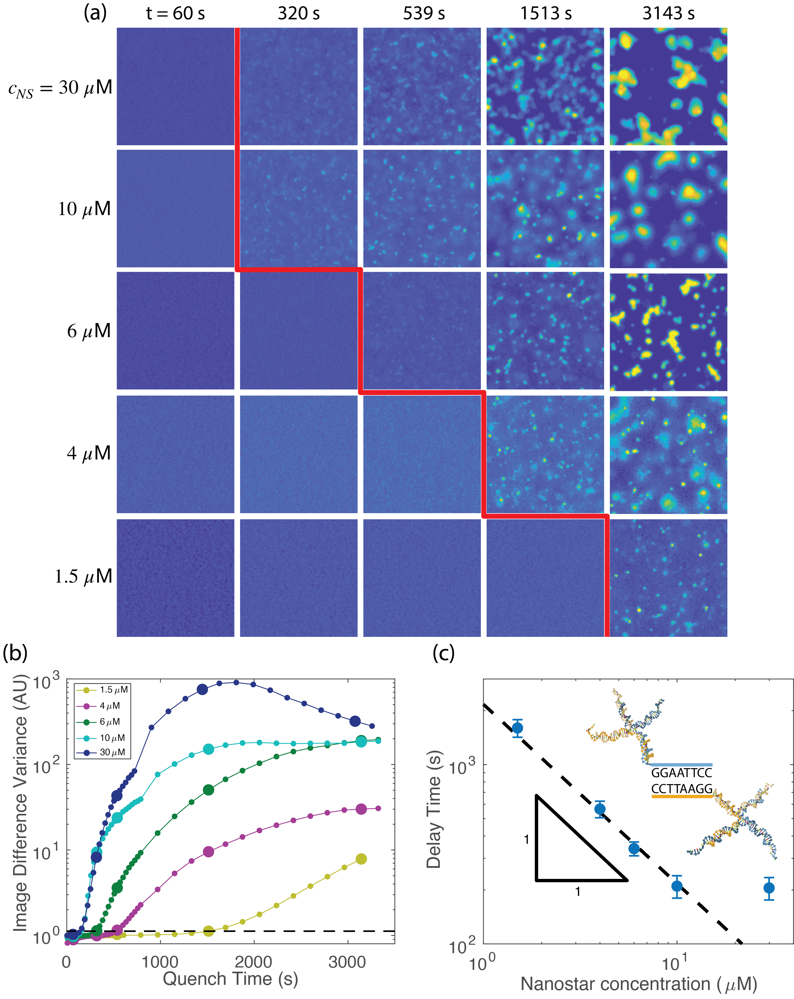
UC Santa Barbara MRSEC
DMR-2308708
Nucleation Dynamics of a Model Biomolecular Liquid
Omar Saleh (UC Santa Barbara)
A model phase-separating system of DNA nanostars provides unique access to nucleation physics in a biomolecular context. At low DNA concentrations, highly thermo-responsive DNA hybridization drives phase separation near room temperature.
By measuring the delay time before phase-separated droplets appear, UC Santa Barbara MRSEC researchers have demonstrated that DNA nanostar phase separation dynamics reflect that of a metastable mixture of patchy particles.
For deep quenches, droplets undergo spinodal decomposition and grow spontaneously through Brownian motion and coalescence, as confirmed by experimental measurements and particle simulations.
Near the coexistence boundary, droplet growth slows substantially and can be predicted by a classical nucleation picture.
These dynamical principles are relevant to behaviors associated with liquid–liquid phase separating systems, such as their spatial patterning, reaction coupling, and biological function.
(a)
(b)
Brownian motion + coalescence:
$$⟨R⟩={\left(\frac{2k_{B}Tc_{NS}}{πηc_{dense}}t\right)}^{1/3}$$
$$t_{d}∼(c_{NS})^{−1}$$
DNA nanostar condensation dynamics. (a) Fluorescent images of droplet formation process after a deep temperature quench into the coexistence regime (Tm − T = 6 °C) for varied concentrations cNS. Images 100 µm x 100 µm (b) Droplet appearance delay time (red line in (a)), plotted as a function of nanostar concentration, shows a power law behavior consistent with Brownian motion and coalescence.
Wilken, Gutierrez, Saleh, Nucleation dynamics of a model biomolecular liquid, J. Chem. Phys. 160 (2024) 214903. DOI: 10.1063/5.0204125
Notes:
What Has Been Achieved: Please see above.
Importance of the Achievement: Dynamical principles are relevant to behaviors associated with liquid–liquid phase separating systems, such as their spatial patterning, reaction coupling, and biological function.
How is the achievement related to the IRG, and how does it help it achieve its goals? An important goal of IRG-2 is to develop bioinspired sources of plasticity and highly deformable gels.
Where the findings are published: Wilken, S., Gutierrez, J., & Saleh, O. A. (2024). Nucleation dynamics of a model biomolecular liquid. The Journal of Chemical Physics, 160(21). DOI: 10.1063/5.0204125

